Slide 1
2021 OTO Growth Trends Report

Slide 2
Residential Units
Single-family + Multi-family - Demolitions = Total Units Added
For each jurisdiction within the OTO study area
Growth Trend Maps
Residential Construction Permitting Activity
Migration
Inflow
Outflow
Demographics & Employment
Population growth
Minority population
Age/Sex Pyramids
Employment/Jobs

Slide 6
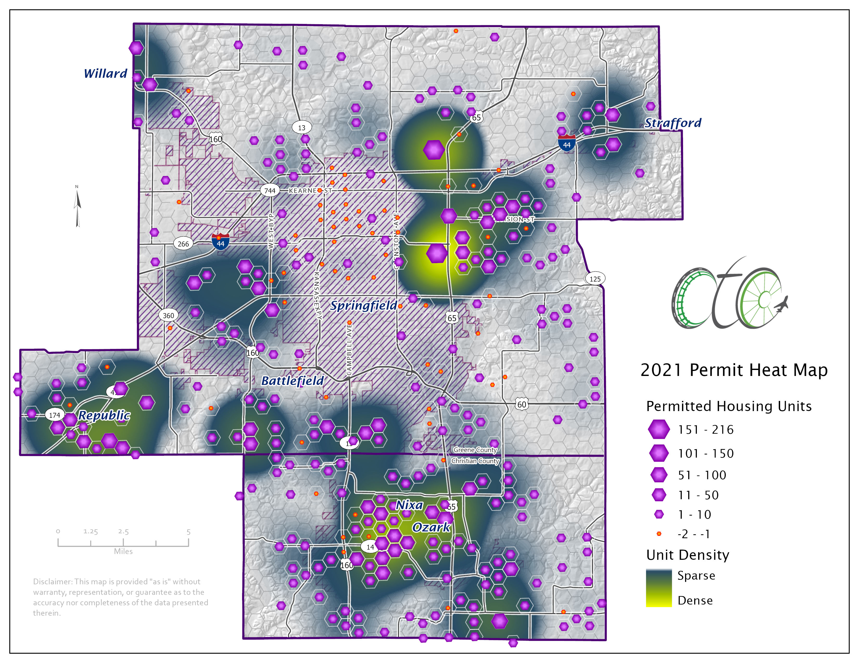

Slide 7
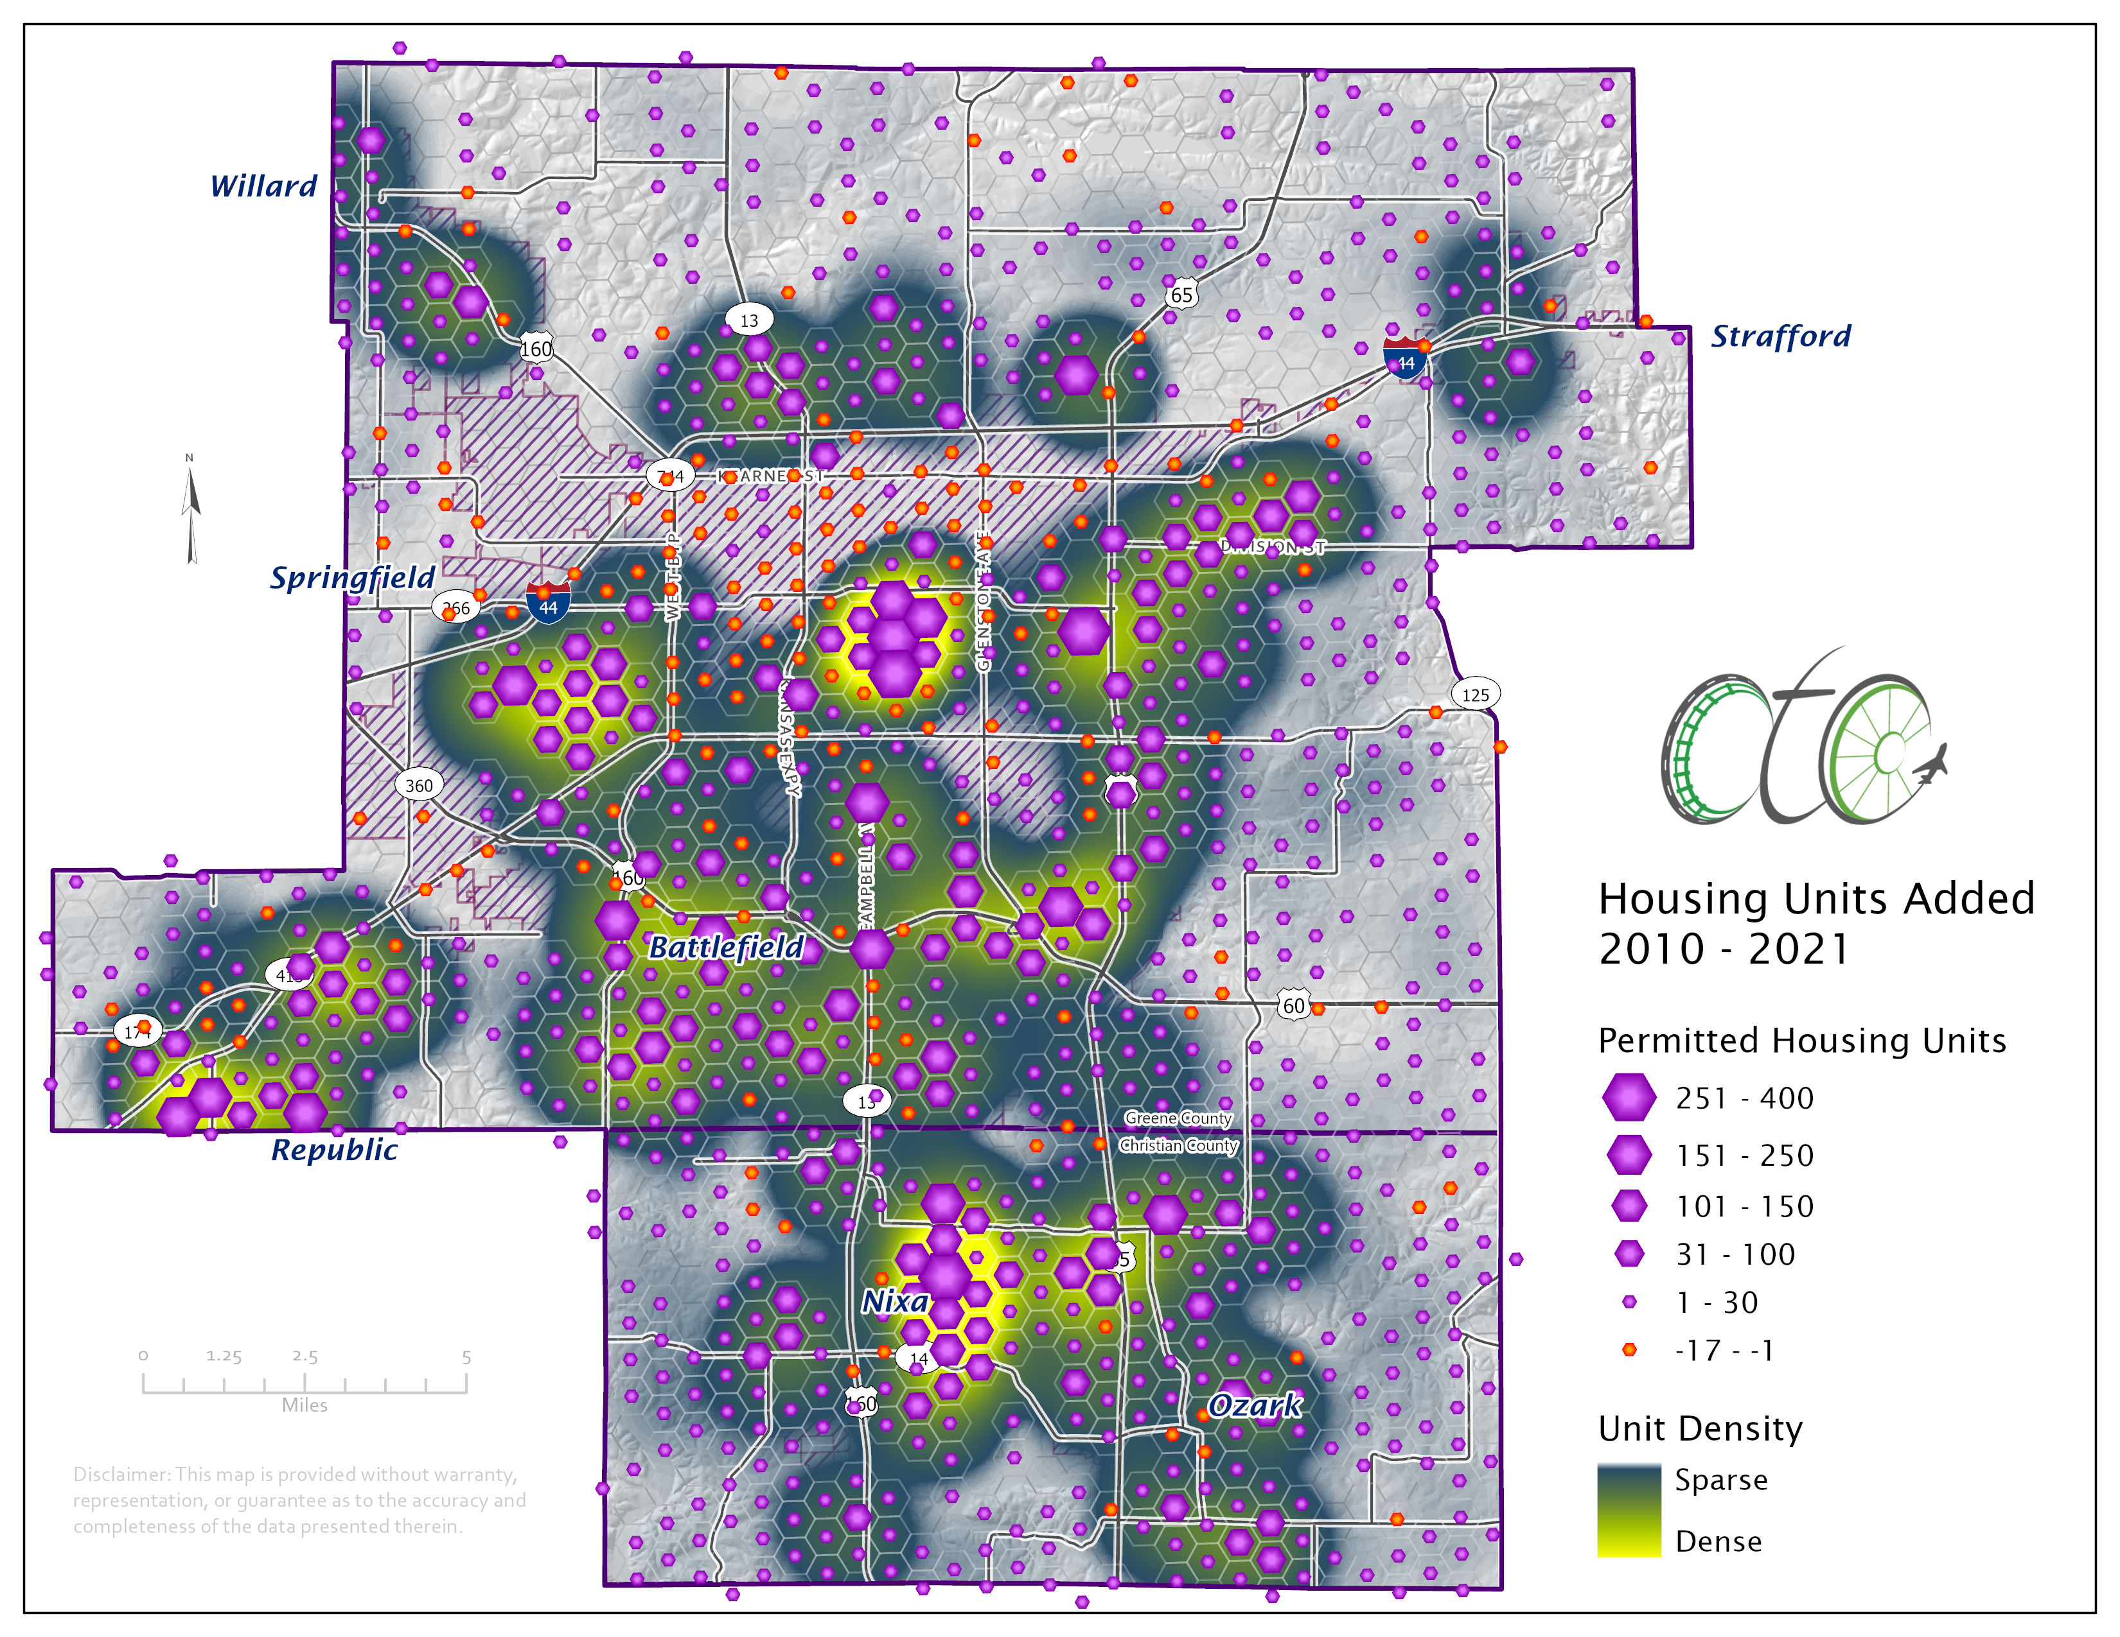

Slide 8
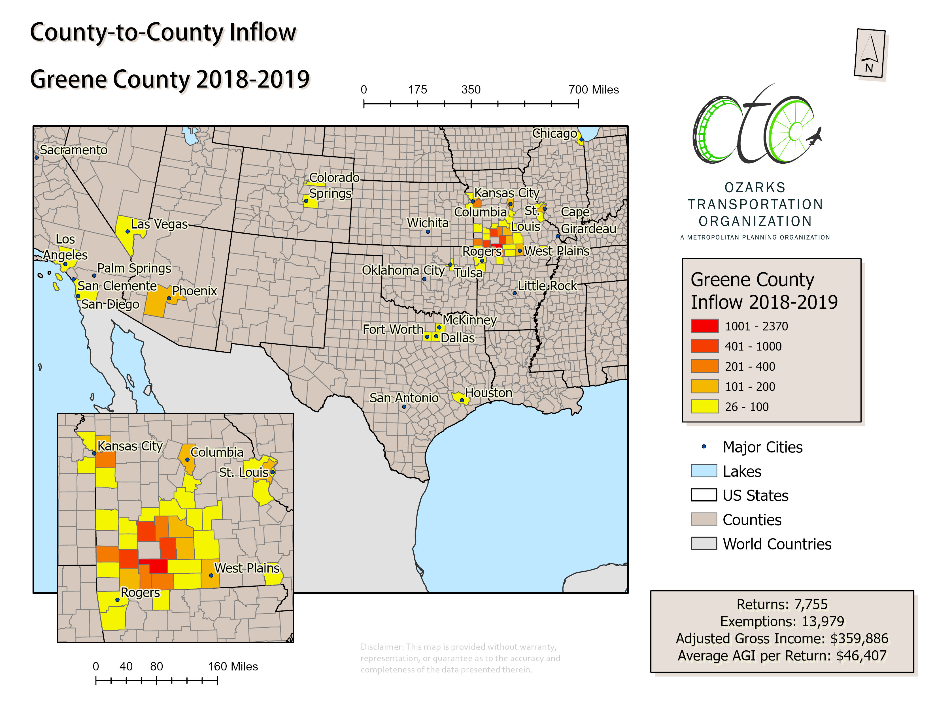

Slide 9
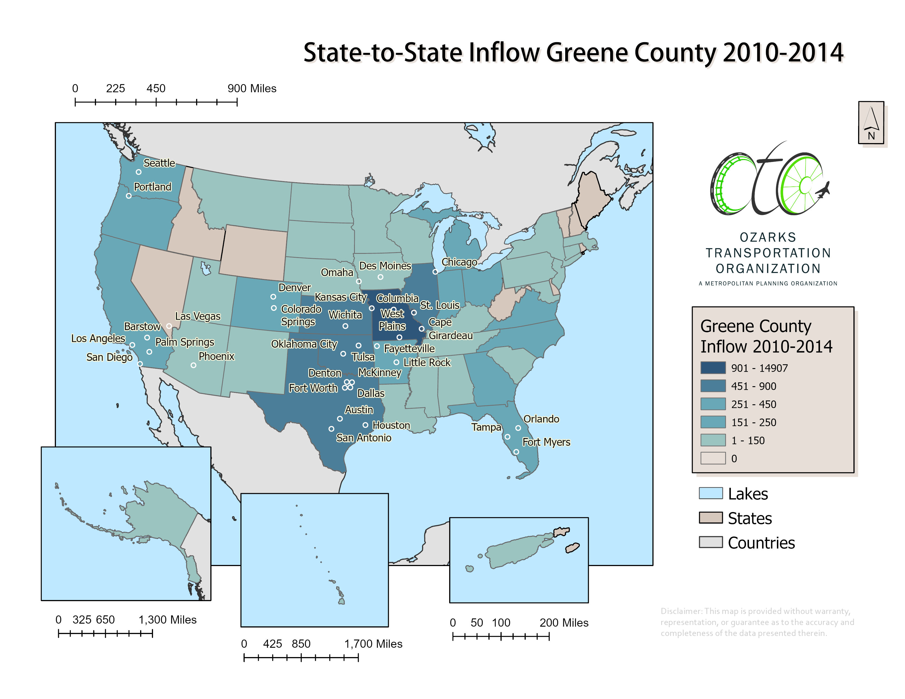

Slide 10
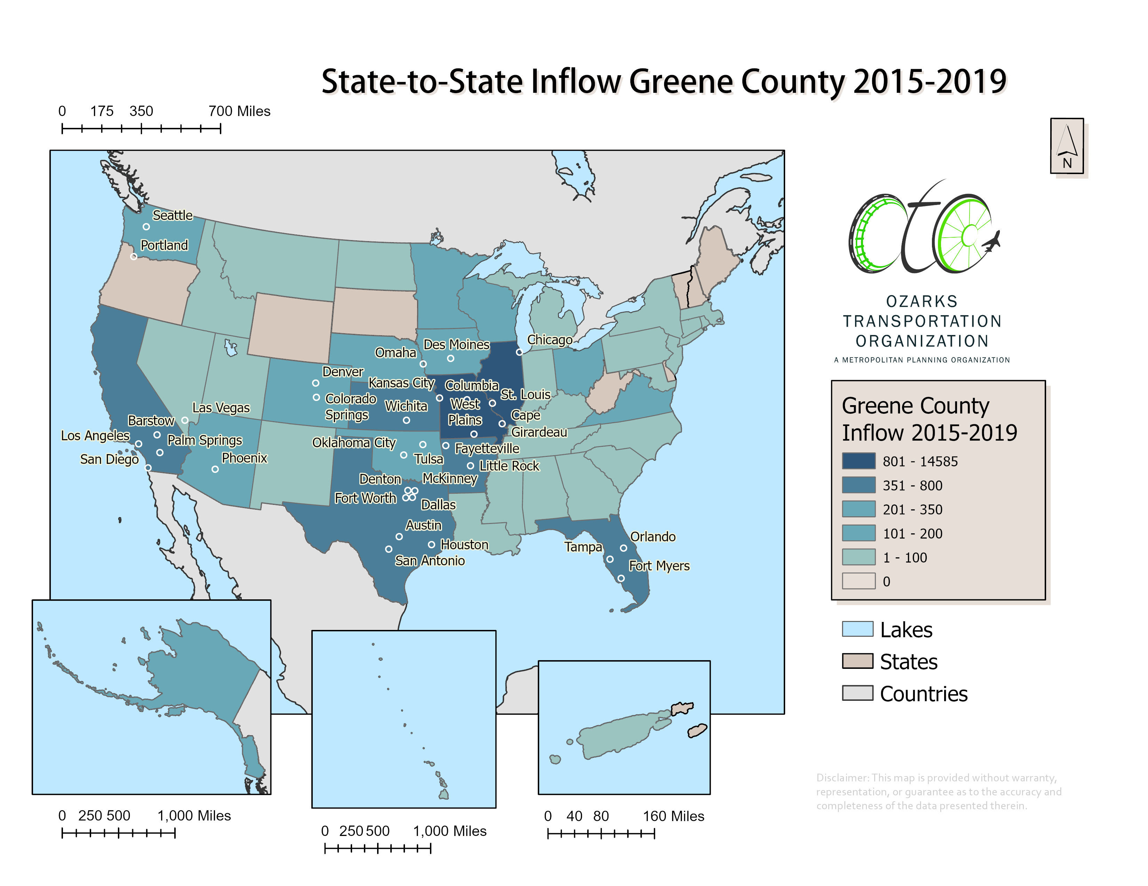

Slide 11
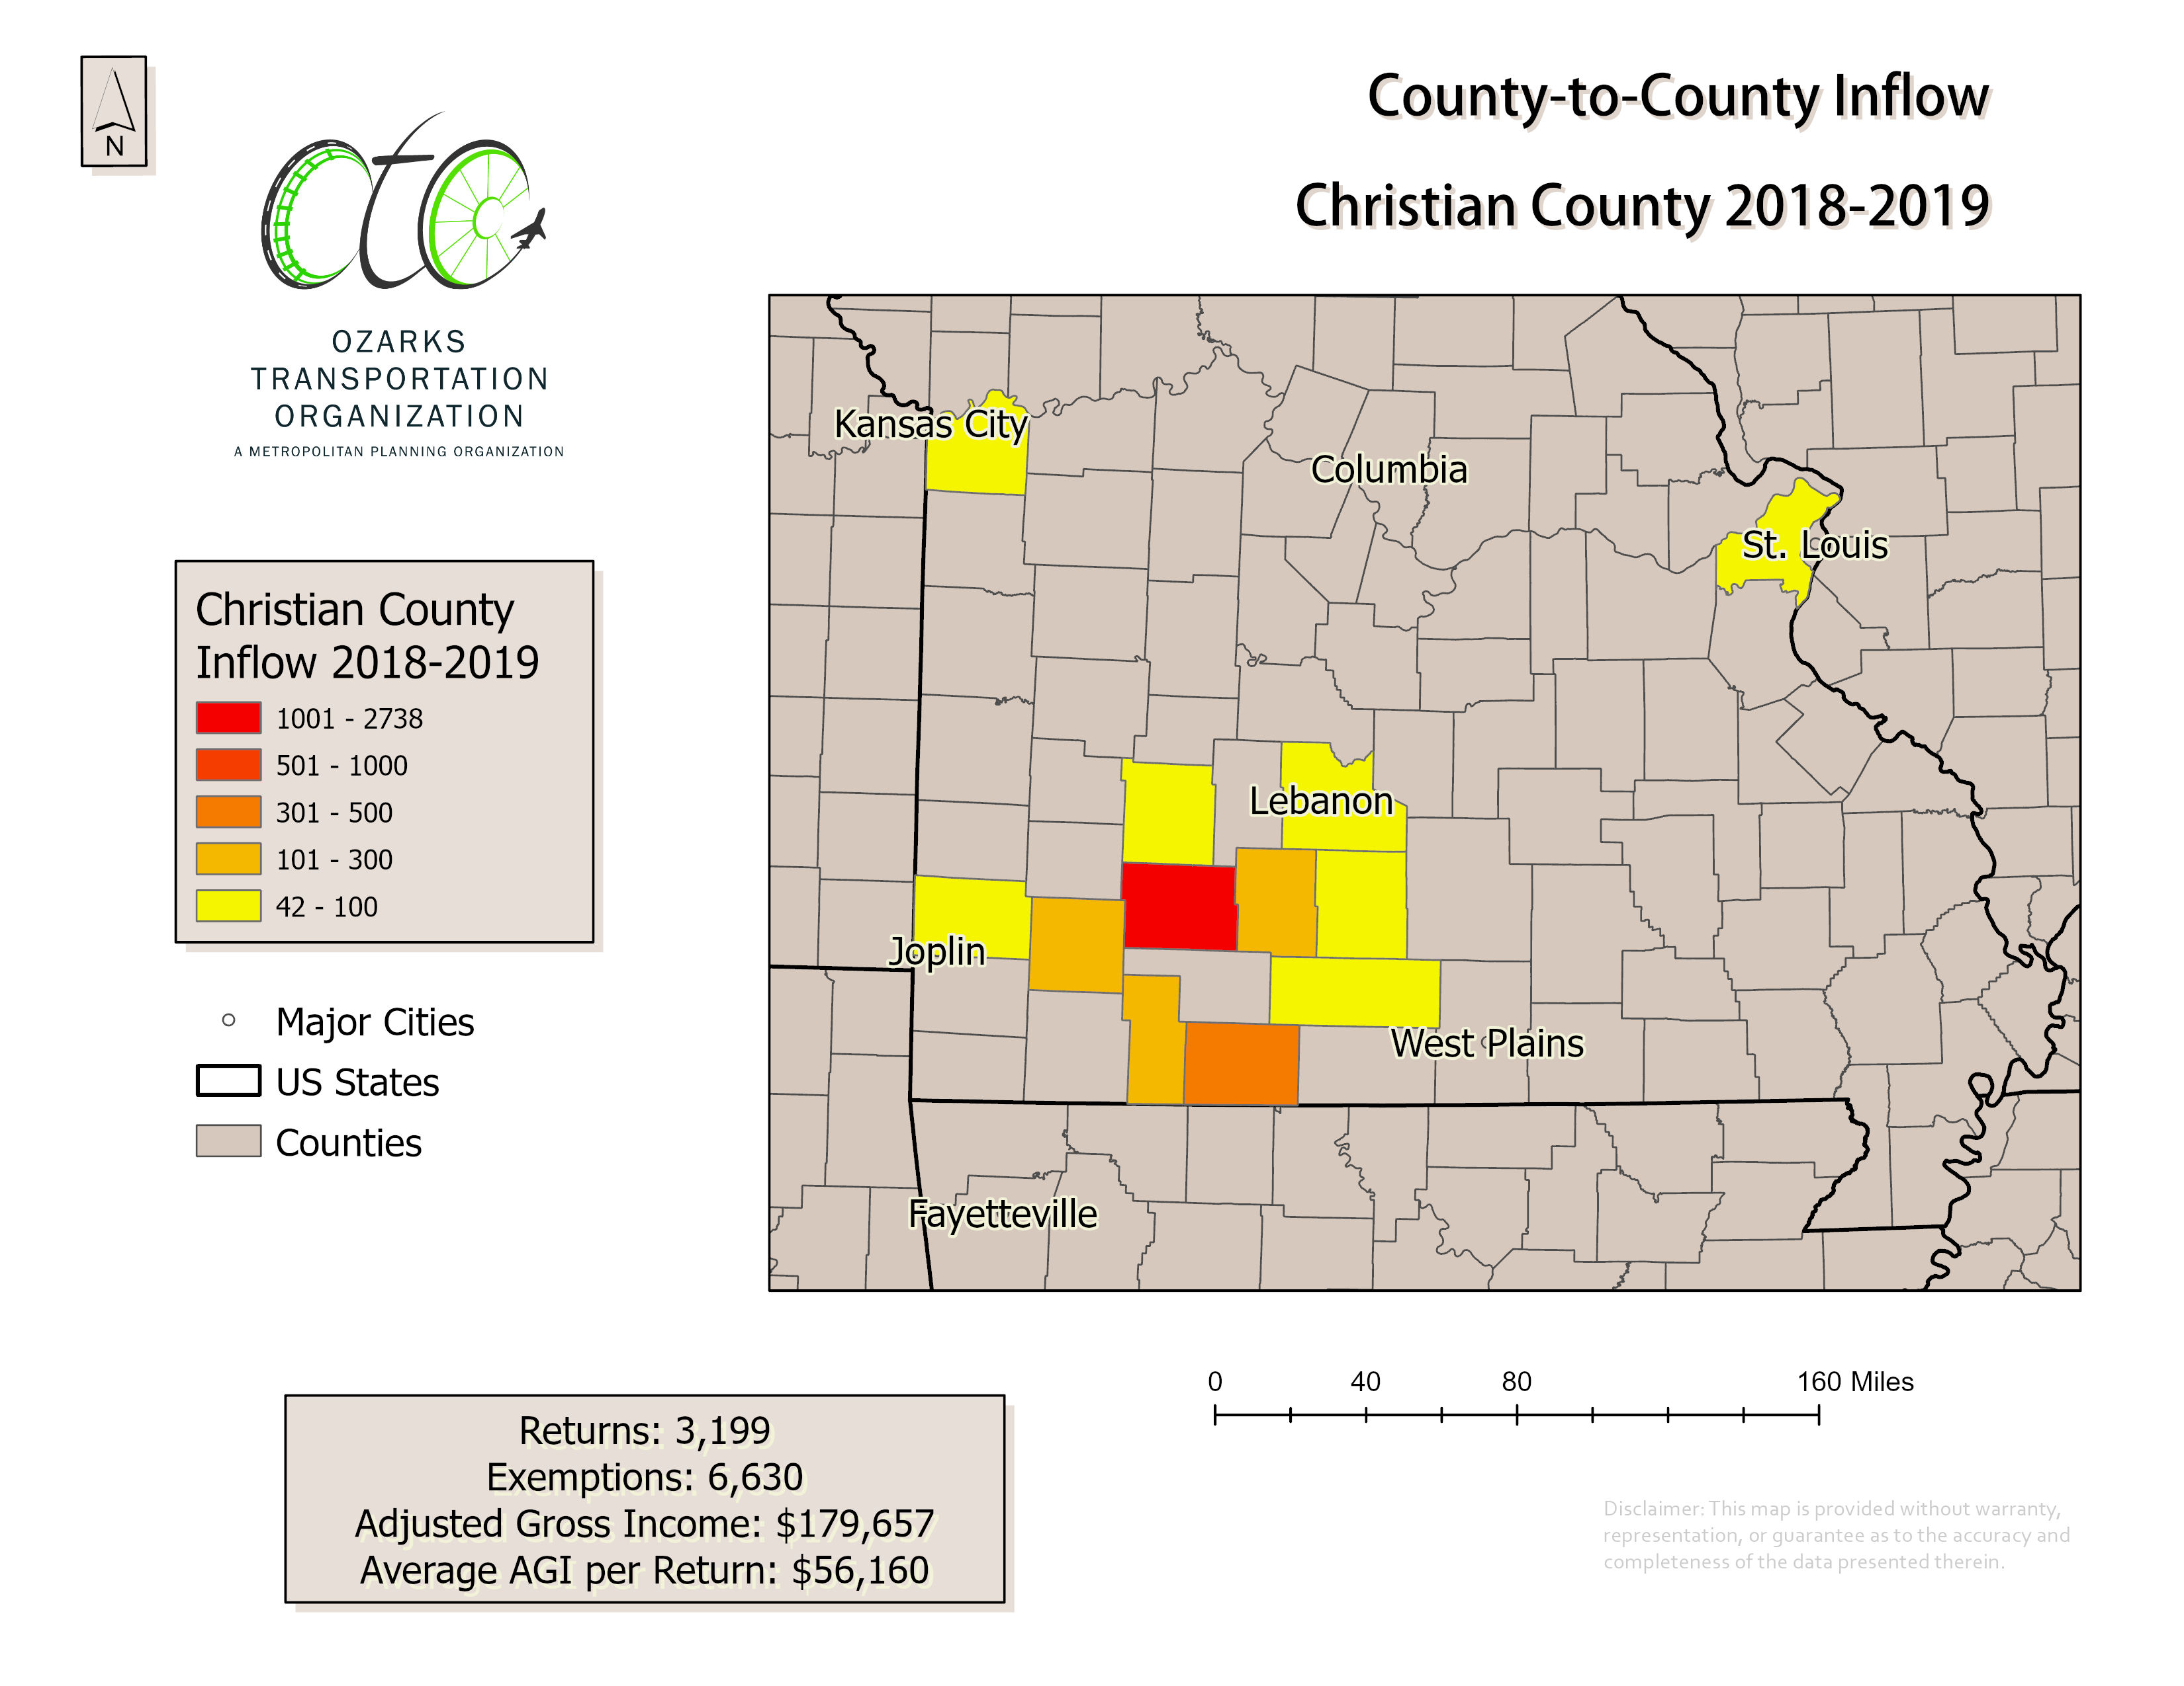

Slide 12
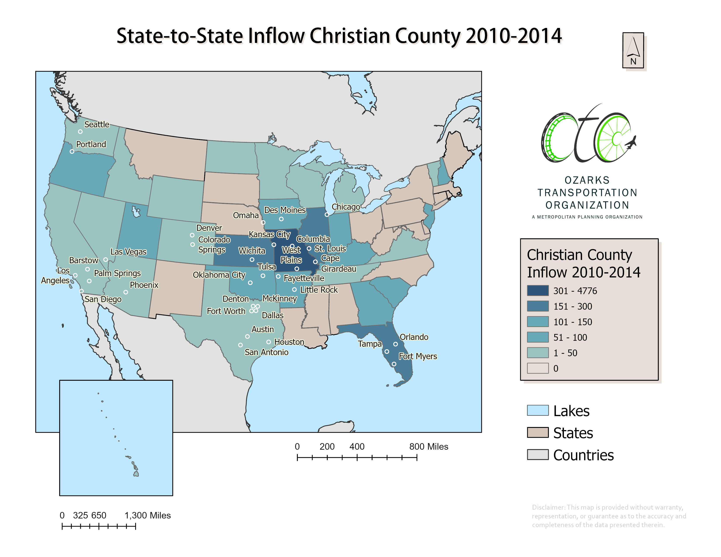

Slide 13
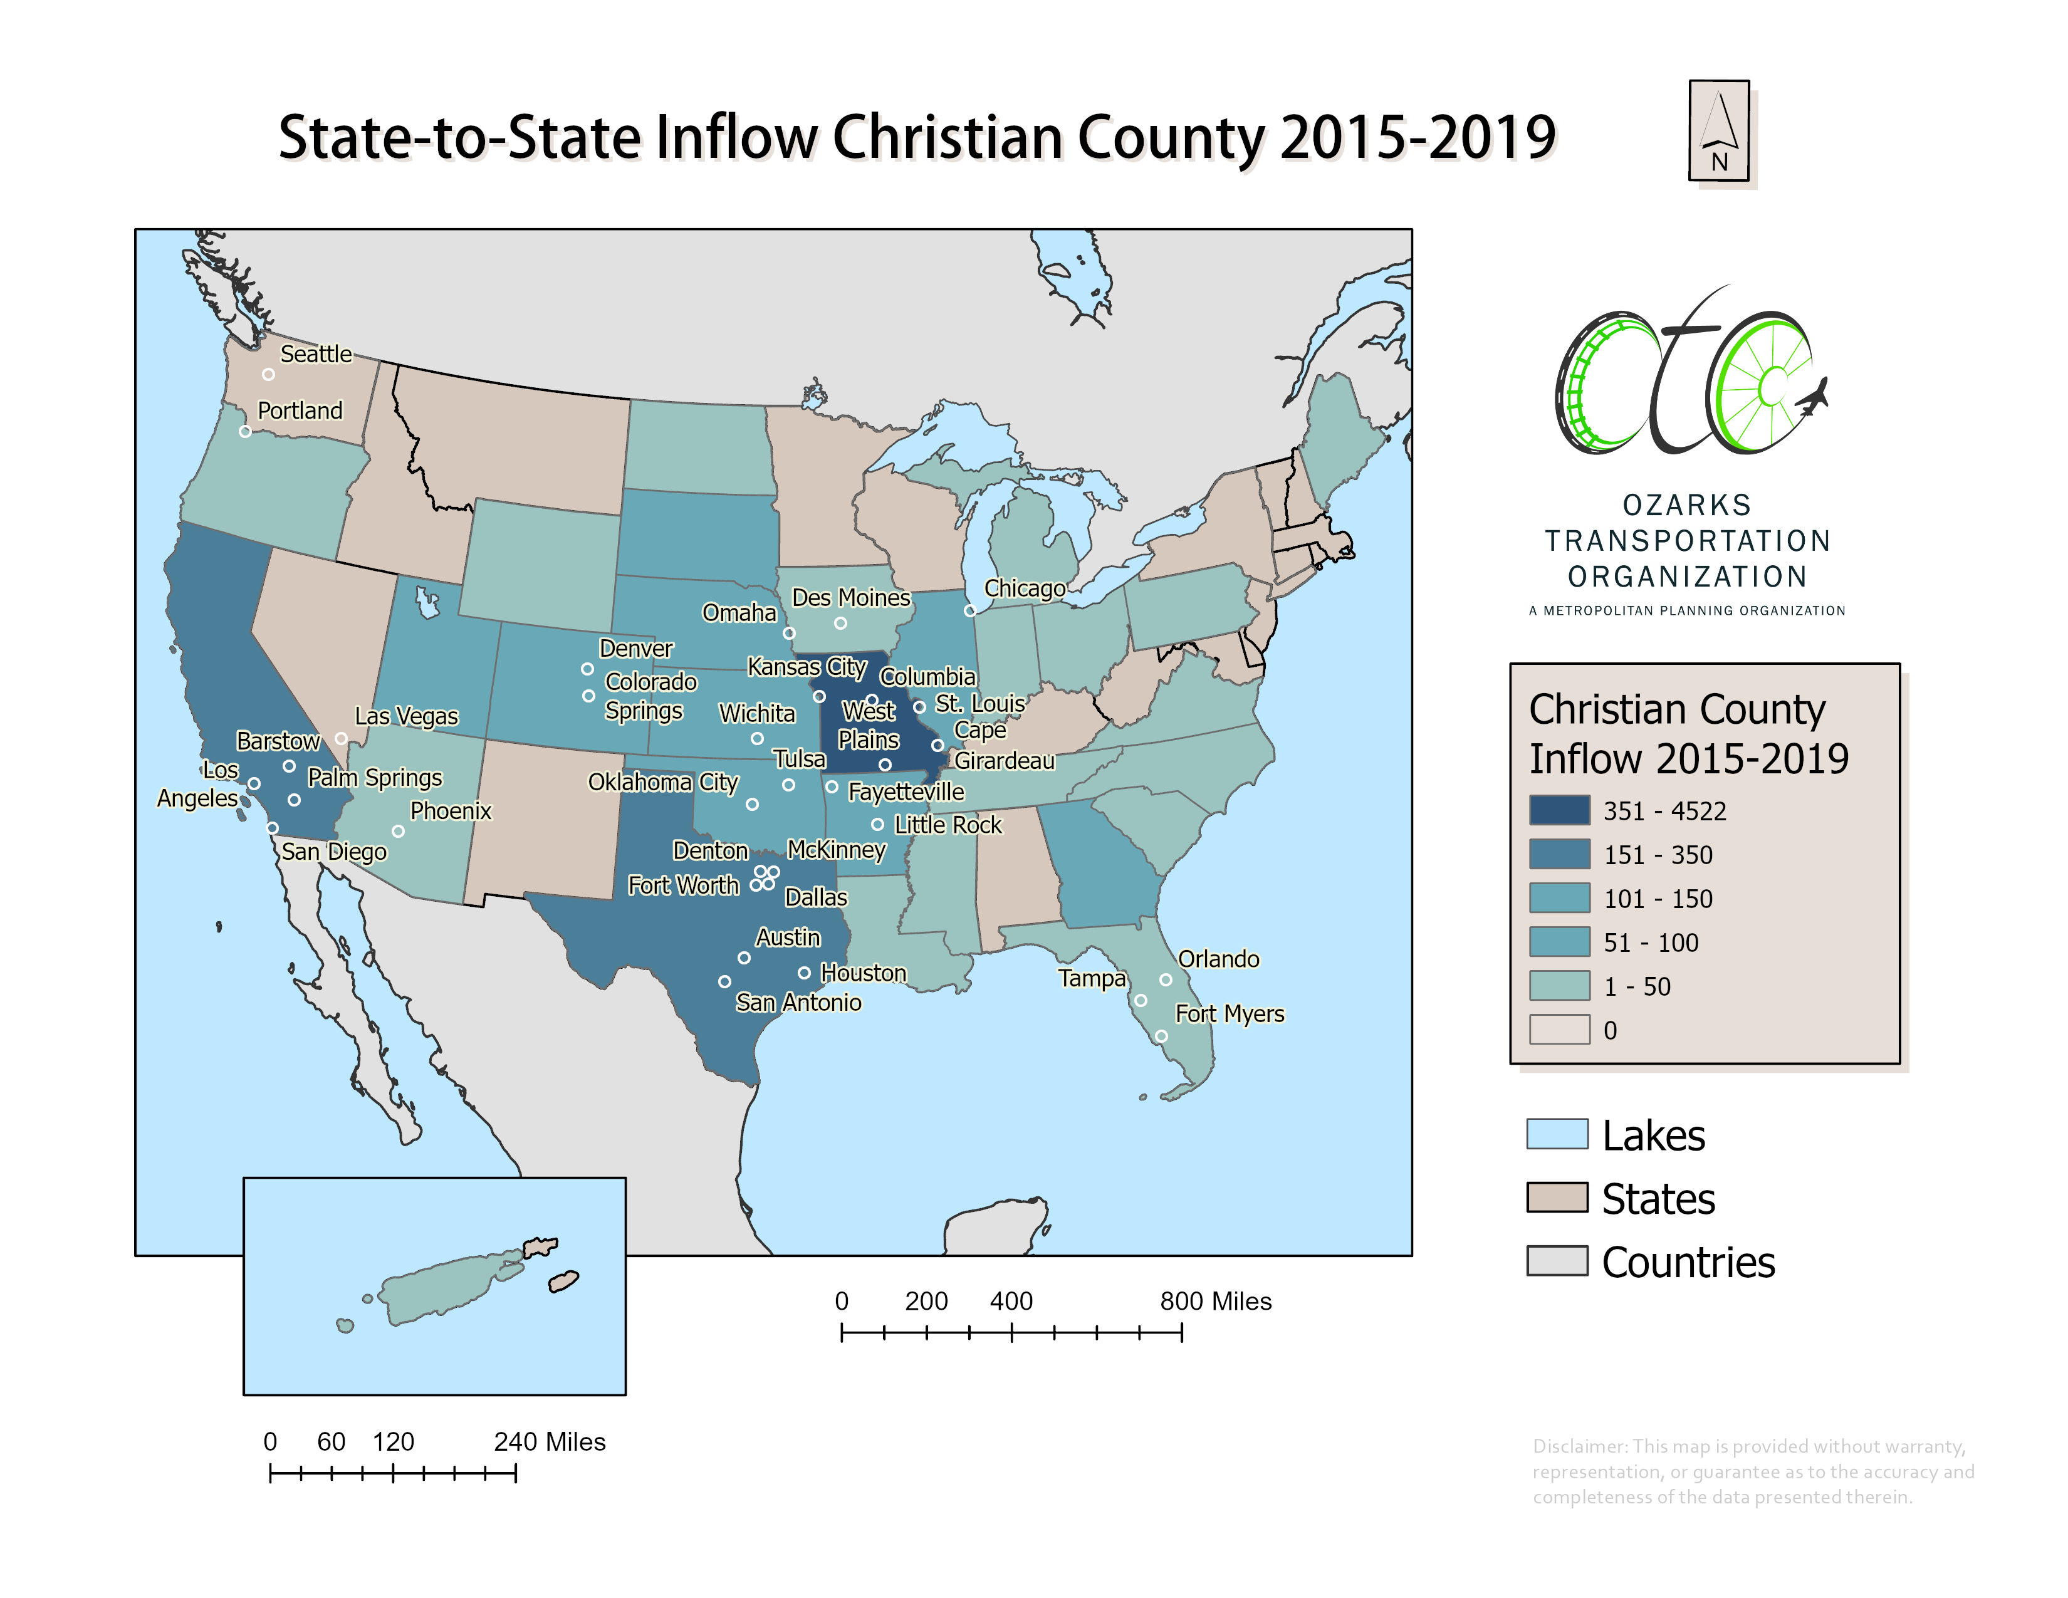

Slide 28
Greene County In-Migration Race Characteristics

Slide 29
Christian County In-Migration Race Characteristics

Slide 31
Appendix A: OTO Area Permit Activity 2001 - 2020

Slide 32
Appendix B: Year-over-Year Population Percent Change 2000 - 2020

Slide 33
Appendix C: Year-over-Year Total Jobs Percent Change 2000 – 2020 & Daily Vehicle Miles Travelled

