Slide 1

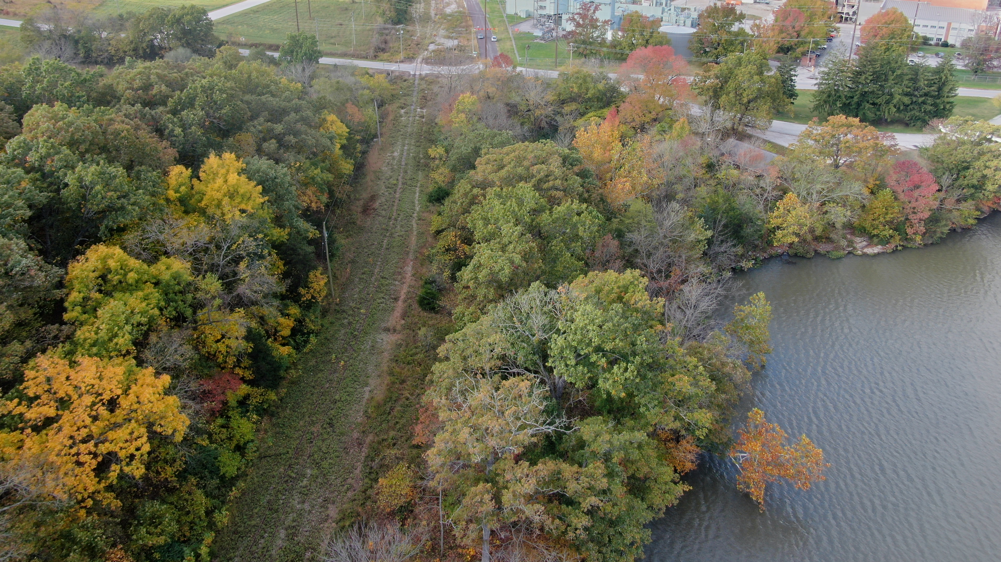


FY 2023 Budget
Operational

Slide 2

Revenue - $2,688,344
$889,575
Consolidated Planning Grant
$245,000
N. Highway 13 Corridor Study STBG
$1,132,750
Chadwick Flyer Trail Construction Project – CRRSA
$180,743
STBG – OTO
Local Jurisdiction Dues
$161,250
$84,000
Other Fees and Match

Slide 3
Local Jurisdiction Dues
Dues Assessment for Grant Match
Benefit for Jurisdictions
The OTO assesses the local jurisdictions dues at 47 cents per census capita for match on the federal grants.
The amount for FY 2023 is $161,276.
The Jurisdictions have access to $7.45 million in Surface Transportation Block Grant (STBG) Funds for FY 2023.
OTO prepares the required planning functions for the region to receive the federal transportation funds.

Slide 4
Difference Between UPWP and Operational Budget
Operational Budget
UPWP Budget
Main OTO Budget – Combines the different grant budgets.
Includes items not allowed through the Consolidated Grant Agreement for federal funds – (UPWP Budget)
Media Expenses
Organizational Promotional Items
Legislative Education
Banking Fees
Additional Grants – CRRSA and STBG funded projects.
Includes In-Kind Match
Includes MoDOT Direct Cost Match
$210,000 in Transit planning funds shown for the region, but not received by OTO

Slide 5


Personnel and Professional Services
FY 2023

Slide 6
Personnel
6 FTEs
I FTE Contract Employee
1 PTE Intern
COLA budgeted at 2% January 2023
Merit raises budgeted
Benefit quotes were obtained and elected to keep same insurance providers
20% increase budgeted effective January 1, 2023

Slide 7
Professional Services
Legal Services (Attorney)
Audit – will be a Single Audit
Payroll Services
Accounting Firm
Design & Graphics
HR Consultant
Why?
OTO budgets to hire professional services as needed. This is lieu of hiring staff to perform these functions.
Also helps small staff with separation of duties for internal controls.

Slide 8

Operating Expenses
FY 2023

Slide 9
Operating
Copy Machine – lease vs. purchase completed. Budgeted $12,500 for purchase of replacement machine.
Education/Training – professional certifications must be maintained by staff. Executive Director is the Chair of the AMPO Policy Committee. Pre-COVID training levels and additional staff budgeted.
Meetings – budgeted at pre-COVID levels. Inflation was factored into food pricing.

Slide 10

Information Technology
FY 2023

Slide 11
Information Technology
IT Managed Services – going out to bid for new contract.
Computer Upgrades/Equip Replace – budgeted for upgrade to Network Attached Storage (NAS) and normal computer rotation.
Software includes the ESRI GIS licenses.

Slide 12

Services – Data, Consultants, and Construction
FY 2023

Slide 13
Services and Projects
Aerial Photography Every 2 years - $25,000
Data Acquisition (New) $21,000
Transportation Improvement Program (TIP) Tool Maintenance - $15,228
Trail Construction Chadwick Flyer Trail Phase III - $1,200,000

Slide 14
Services and Projects
N. Highway 13 Corridor Study - $240,000 completed in FY 2022 but final payment in FY 2023
Transportation Consultant for grants and studies - $155,000
Includes the final payments on the FF Corridor Study included in FY 2022 and brought forward to FY 2023
Travel Demand Model Update - $15,000

Slide 15
Total Expense - $2,726,618
$812,503
Personnel
$72,722
Operating
$16,500
Commodities
$45,900
Information Technology
Insurance
$10,700
$1,686,233
Services
$82,060
Building

Slide 16

Fund Balance

Slide 17

Estimated $500,000 + at start of FY 2023
Financial Policy – 3 to 6 months operating fund balance
3 to 6 months of FY 2023 Budget is $312,653 to $643,306 range
OTO Operational Budget - $1,286,613 (minus the Chadwick Flyer Trail Phase III and the Highway 13 Corridor Study)

Slide 18

Approval Process

Slide 19

Executive Committee Recommendation
Preliminary Budget Draft
February 9, 2022
Final Budget Draft
April 13, 2022
Recommended to BOD

