Slide 1
Chadwick Flyer Trail -- US65 Crossing Study

Slide 2
Purpose of US65 Crossing Study
US Highway 65 divides the rail corridor/trail in two
Critical need for a grade separated crossing
Exploration of locations and methods for crossing
1

Slide 3
Option 1 - Overpass near CF rail alignment
Notes:
several locations were explored for the Chadwick Flyer trail to cross U.S. Highway 65, but were dismissed early on due to topographic complications, residential or commercial property impacts, or significant associated costs.

Slide 4
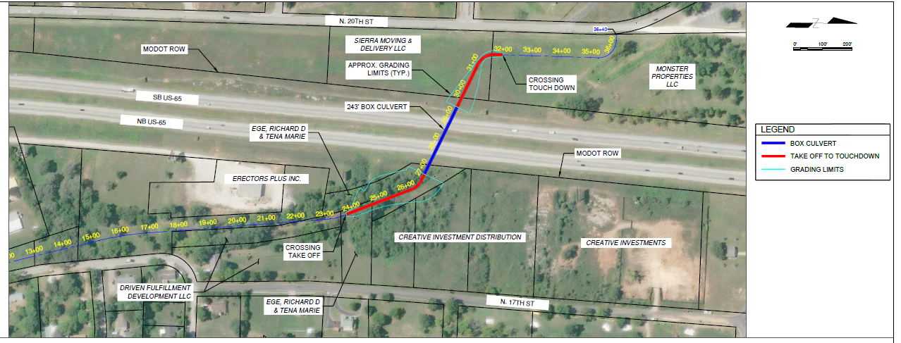
Option 2 – Underpass near CF rail alignment

Slide 5
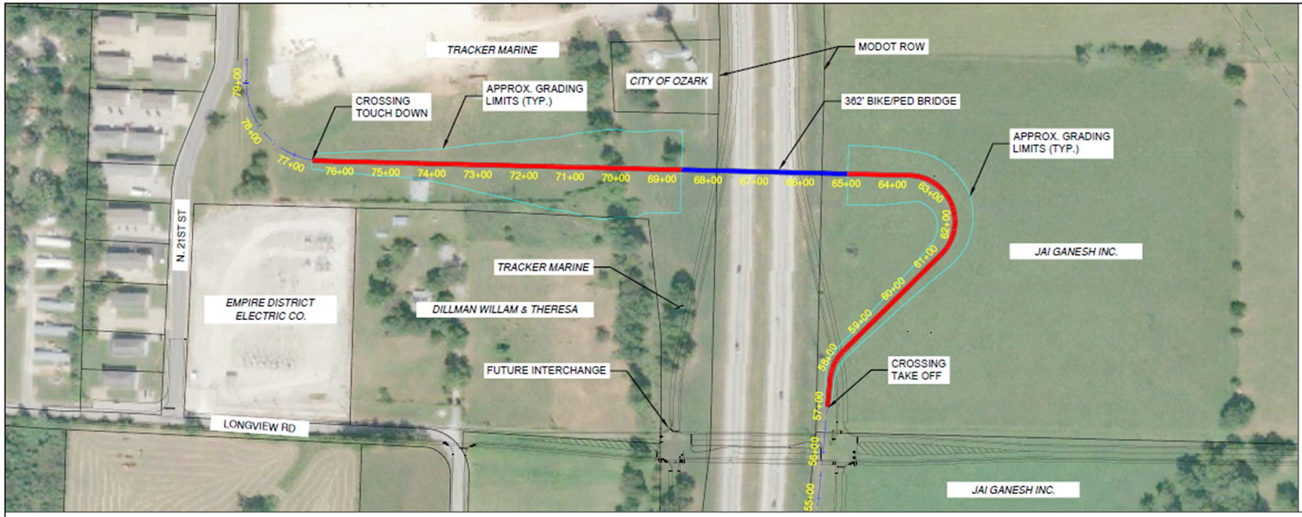
Option 3 – Overpass adjacent to future Longview Rd/US65 Interchange

Slide 6
Estimated Costs of each Option
Option 1 - $2,755,000
Option 2 - $2,775,000
Option 3 - $3,585,000
2
Notes:
Safety
Aesthetics
Maintenance
User comfort
Environmental impacts
Rights-of-way impacts
Costs

Slide 7
Recommended Alternative Option 1 - Overpass near CF rail alignment
Notes:
OPTION 1
Benefits
• Closely follows the original Chadwick Flyer rail alignment
• Provides a more isolated user experience versus following an adjacent roadway
• Independent of future Longview Road and US-65 interchange which will allow for minimal trail closures during construction of the interchange
• Less significant impact to US-65 traffic operations during construction versus an underpass option
• Opportunity for enhanced aesthetics to promote the trail and provide an attractive monument along US-65
Disadvantages
• Narrow right-of-way on south bridge approach may require impacts to adjacent properties if retaining walls or an elevated trail concept are not utilized
• Bridge will be at a skew with relation to US-65 to limit right-of-way impacts and provide a better trail user experience
OPTION 2
Benefits
• Less impact to adjacent parcels due to shorter take-off and touchdown limits of approaches to the box culvert
• Reduced maintenance costs
Disadvantages
• Less opportunity for enhanced aesthetics for trail users and exposure to traveling public on US-65
• Poor user experience for pedestrians and bicyclists traveling underground for approximately 240 feet under US-65
• Greater impact to traffic operations on US-65 for construction of the box culvert. This would require an open cut of the roadway for installation and utilize significantly more traffic control
• Avoiding a newly installed water main west of US-65 could require slower bicycle design speeds of the trail while approaching the underpass to achieve a more perpendicular crossing of US-65 while limiting excavation limits of the trail construction
Option 3
Benefits
• Trail users would cross US-65 closer to a future interchange which may promote more use of the bridge structure and/or Chadwick Flyer Trail
• Lesser impact of trail alignment on established parcels west of US-65
• Opportunity for enhanced aesthetics to promote the trail and provide an attractive monument along US-65
Disadvantages
• The bridge would need to be longer and thus more expensive than the Option 1 overpass due to accommodation of the future interchange ramps. Details about the US-65 and Longview Road future interchange can be found in the Interchange Executive Summary located in the appendix.
• Trail users would travel adjacent to US-65 and the user experience would lack a feeling of off-road or isolation from traditional roadway corridors
• Longer trail closures would be expected during construction of the future Longview Road interchange due to a need for significant reconstruction of the trail alignment.

Slide 8
Full Trail Sections

Slide 9
Public Input
15-Day Review and Comment period -- April 11 to 25, 2022
Total of 30 comments Received
Option 1 (South Overpass)
17 supporting (highest total in support)
1 rejecting
Option 3 (North Overpass)
14 supporting
4 comments rejecting
Future interchange construction complications
Higher costs
Undesirable geometry
Comments supporting Options 1 and 3 – 9 supported either option
Option 2 (South Underpass)
Zero comments in favor
19 comments rejecting
Safety
Maintenance
Poor aesthetics
Overall, public favors Option 1 (South Overpass)
1

Slide 10
Questions????
8

