Slide 1
Springfield Bike Share
Presented by David Hutchison, SBS Board Vice-Chair
Ozarks Transportation Organization, February 28, 2019

Slide 2
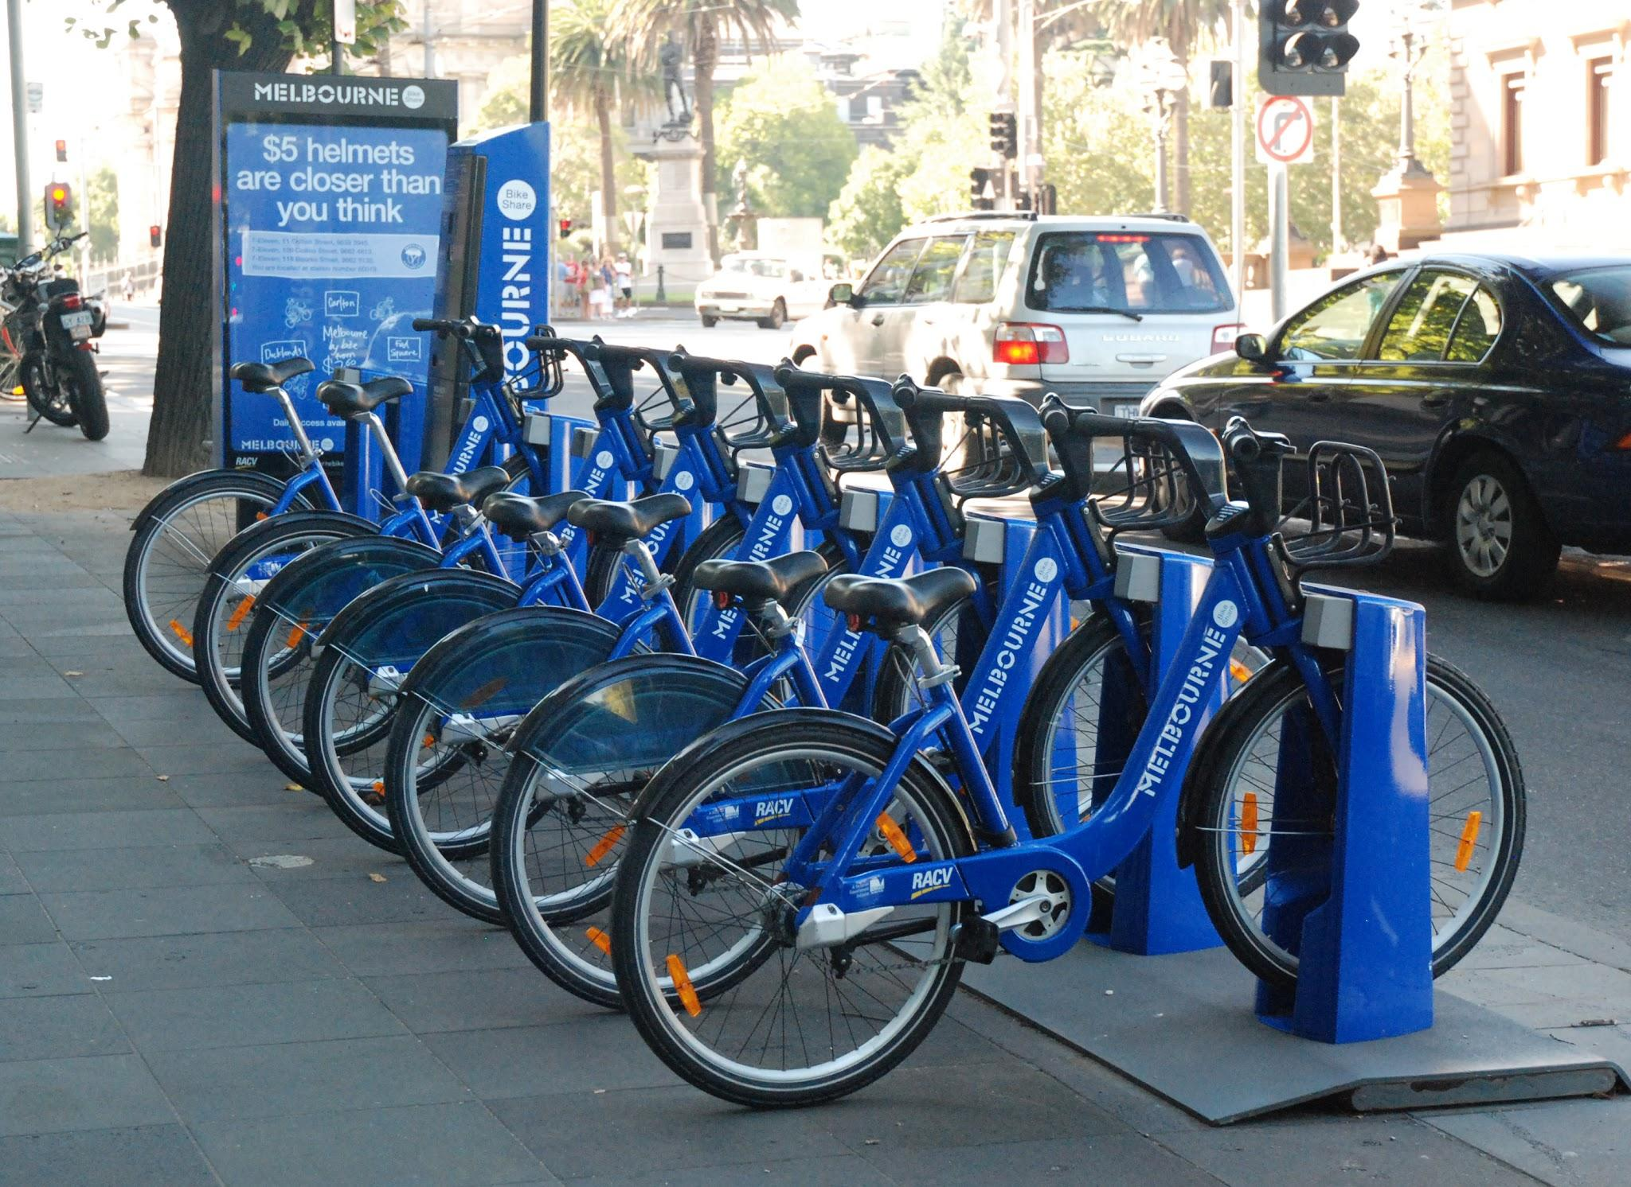
What is bike share?
Bike sharing provides a cost-effective transportation option for trips too far to walk, but not long enough for public transit or driving to be convenient
Consists of a network of stations and bikes that can be taken from a station and returned to any station within the network
Can be used by paying for one trip at a time or by purchasing a subscription for use over several days, a month, or a year

Slide 3
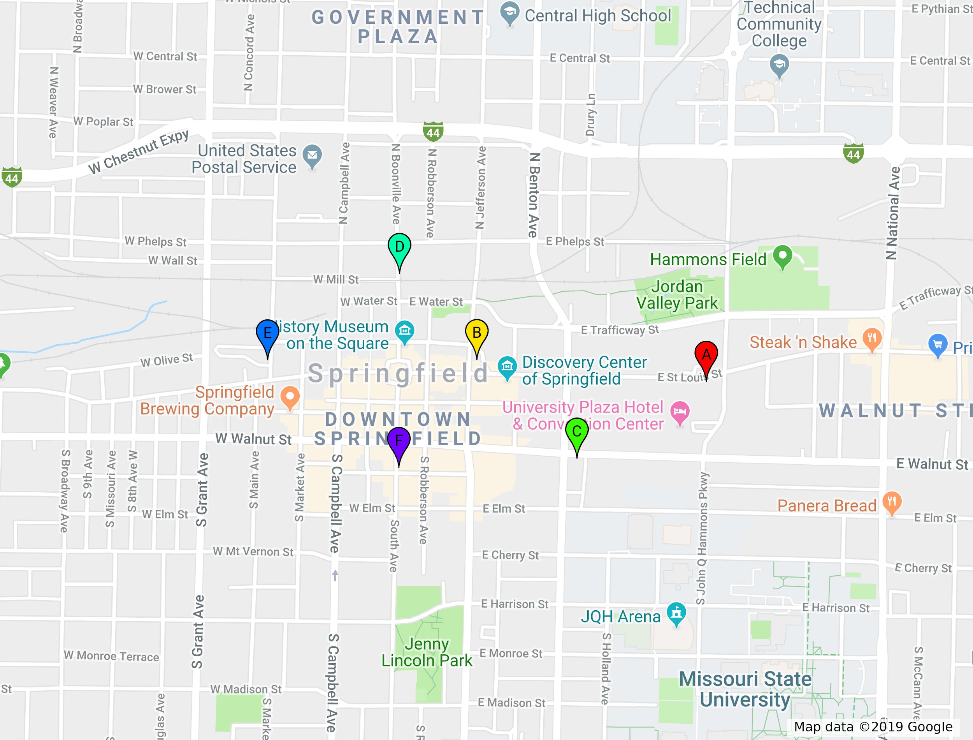
Bike share in Springfield
Launched and maintained by Springfield Bike Share, a local 501(c)3 nonprofit
Downtown Park Central area & Missouri State University (not shown)
6 stations (6-10 bike capacity)
Approx 25-30 electric-assist bicycles

Slide 4
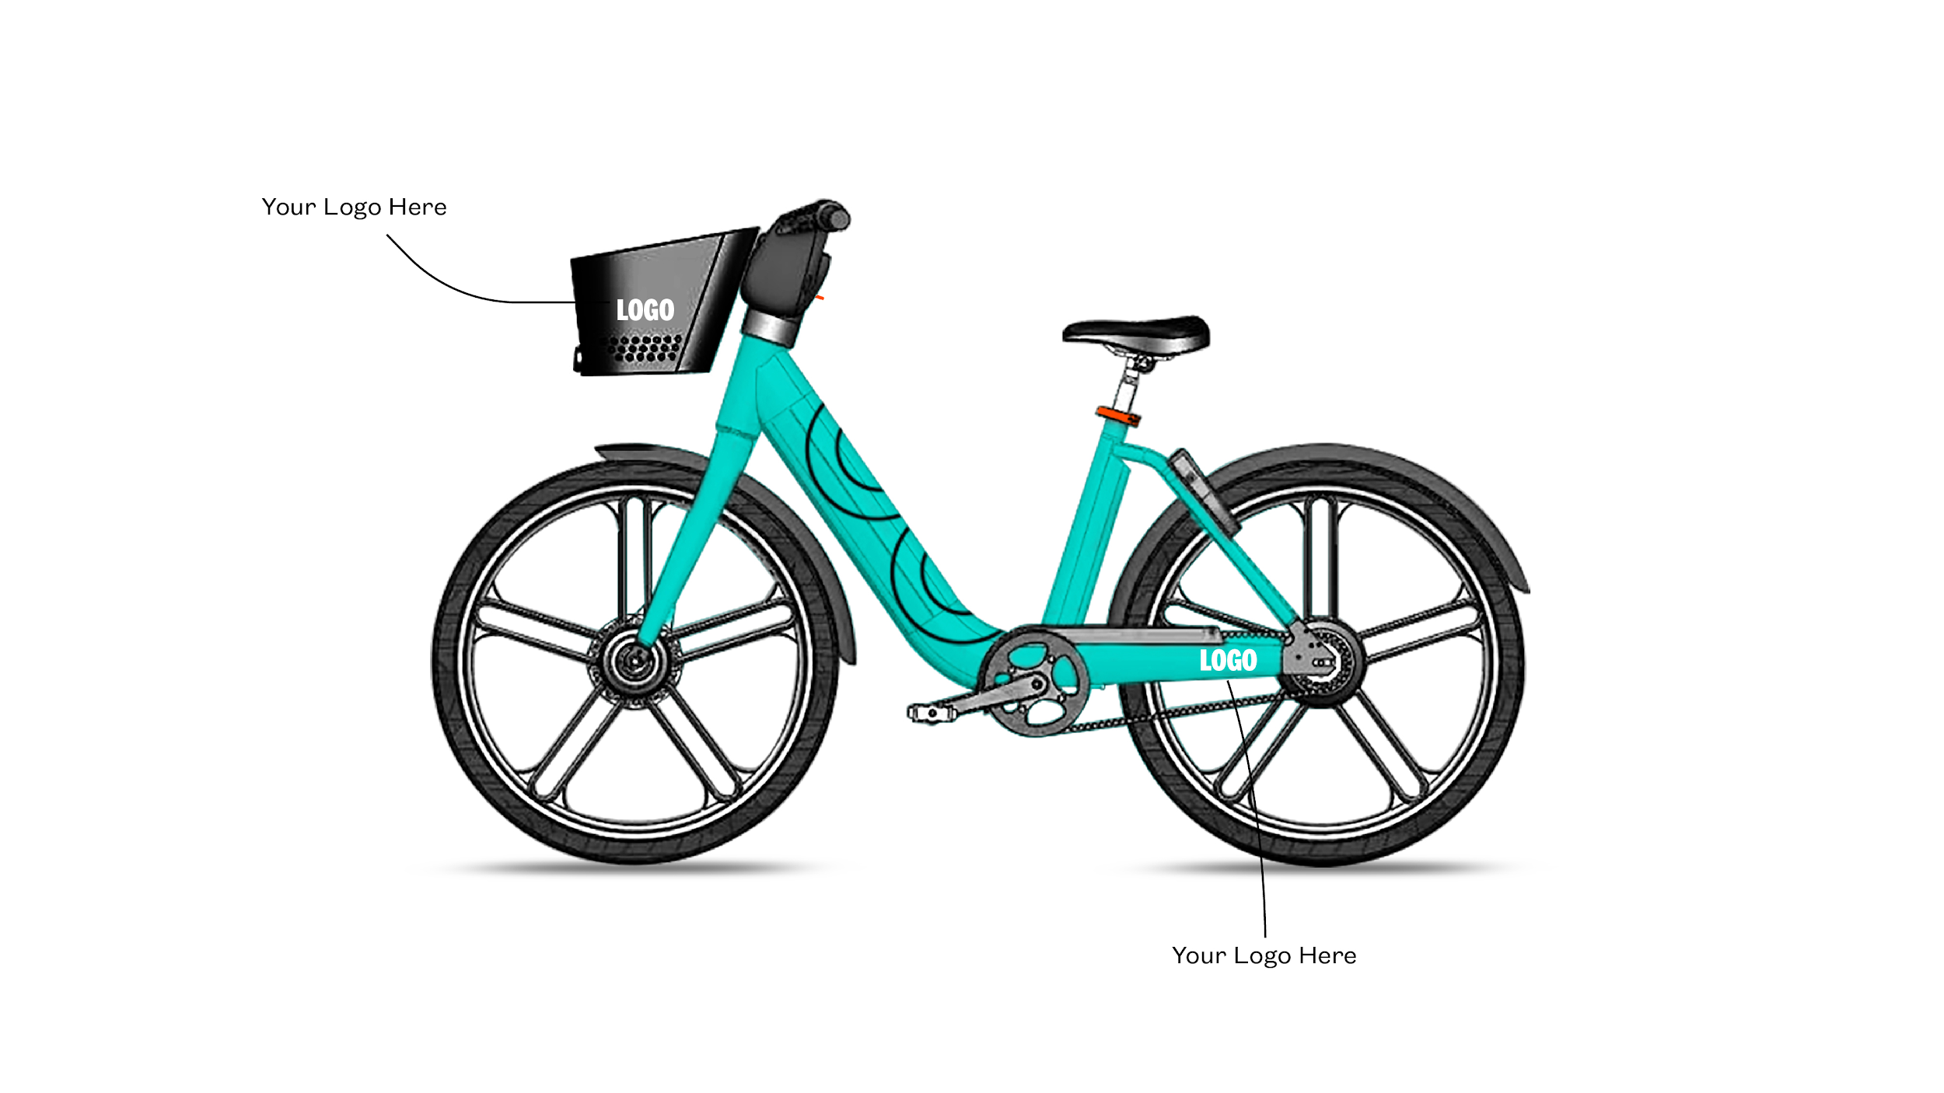
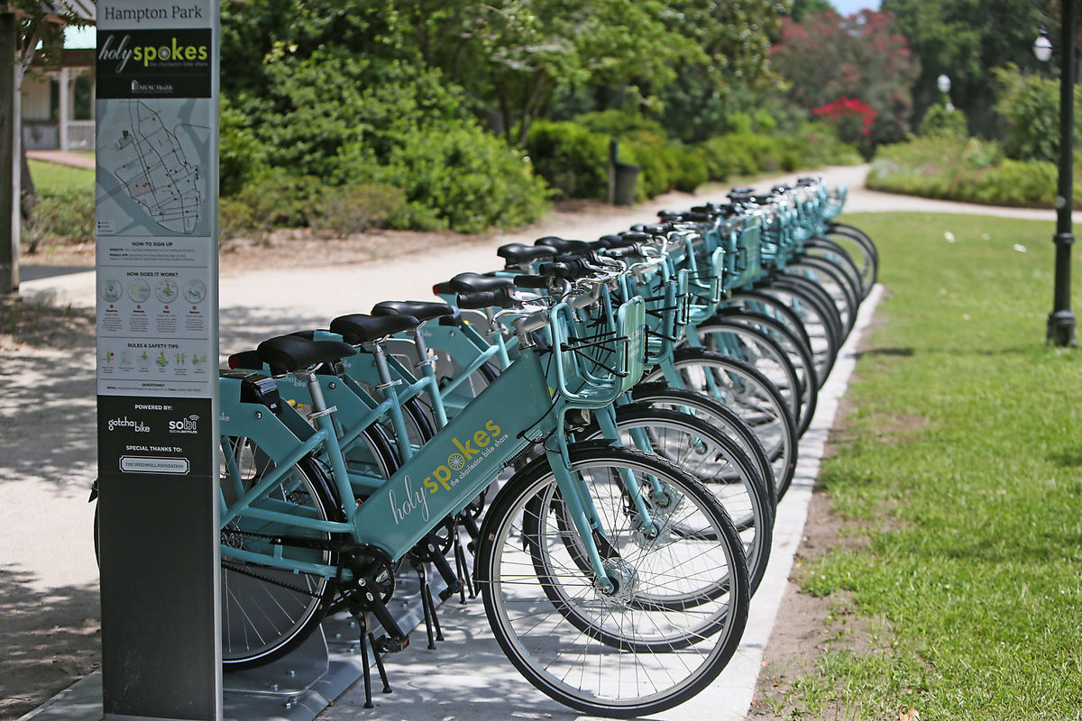
Partnership with Gotcha Bike
Both SBS and MSU are using Gotcha Bike to provide bike share system
Durable smart e-bike with customizable/brandable platform
Easy-to-use interface for checking out and returning bicycles
Versatile back-end analytics
Gotcha Bike handles operations and provides bicycles and SBS maintains bike racks

Slide 5
Our Funding Model
Per-station funding model: $6,000 to sponsor a station for two years
Current revenue source: Corporate and community partners (to-date 90% funded)
Potential future revenue sources: More partners, grant funding, crowdfunding (small gifts)
Pays for installation and maintenance of bike racks and Springfield Bike Share costs
Membership revenue from riders is used by Gotcha Bike to fund bicycles, system operational support, and bicycle repair and maintenance

Slide 6
What will bike share do for Springfield?
Enhance the overall health of the community with an active and enjoyable transportation option
Create a low-cost transportation alternative to complement existing infrastructure
Strengthen Springfield’s central downtown core
Improve the livability of our community
Attract and retain young professionals with a metropolitan amenity

Slide 7
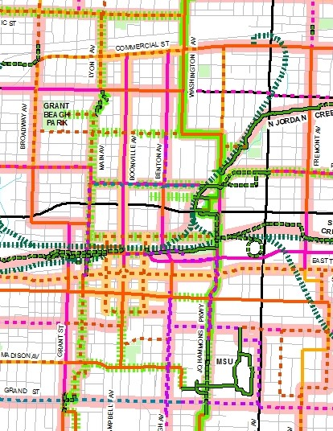
What is next?
Develop agreements with City and Gotcha Bike
Launch pilot system in May or June
Expand system within central Springfield

