Slide 1

Systemic Safety Analysis

Slide 2

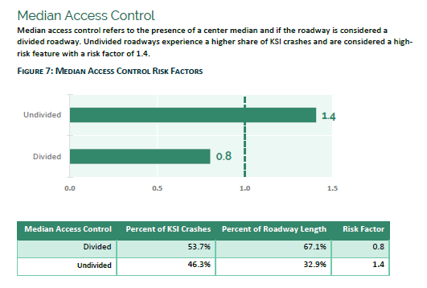
High Risk Characteristics
Intersection Type
Functional Classification
Number of Lanes
Shoulder Type
Shoulder Width
Access Control
Horizontal Curvature
Roadway Type
Area Type
Multimodal Activity

Slide 3
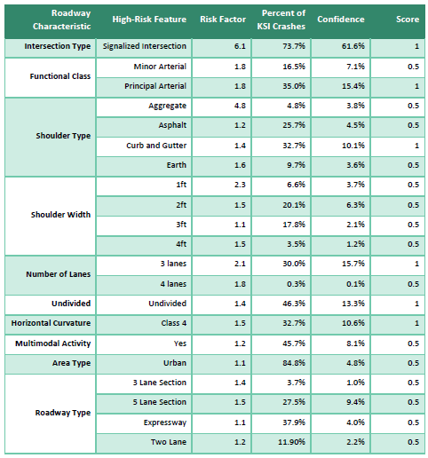

Slide 4
Higher Risk Corridors
Battlefield Street
Chestnut Expressway
Division Street
Glenstone Avenue
Grant Avenue
Kearney Street
MO 14 (Nixa and Ozark)
National Avenue
Republic Street
S. Campbell Avenue
Sunshine Street
US 60 (Republic)

Slide 5
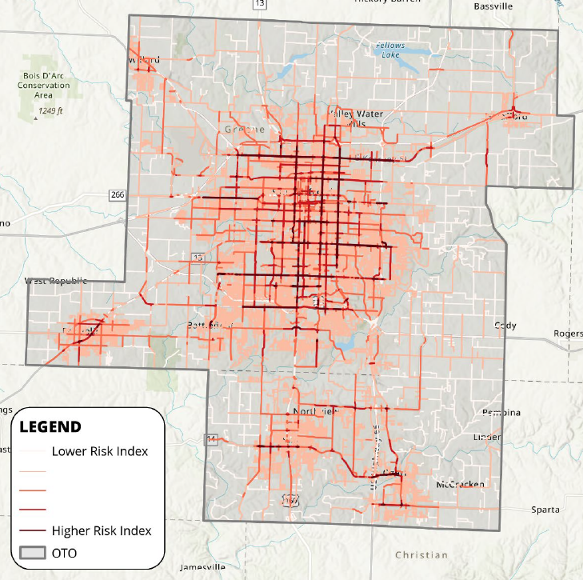

Slide 6
Recommended Strategies

Slide 7
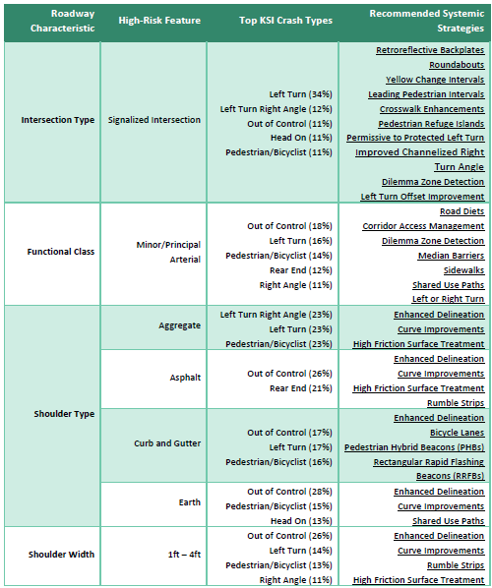
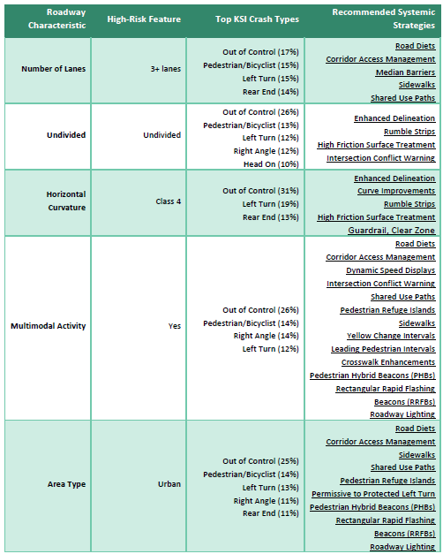

Slide 8
