Slide 1
FY 2025-2028 Transportation Improvement Program
Ozarks Transportation Organization

Slide 2
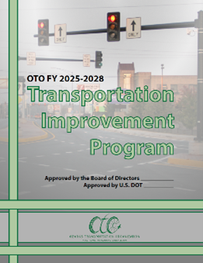

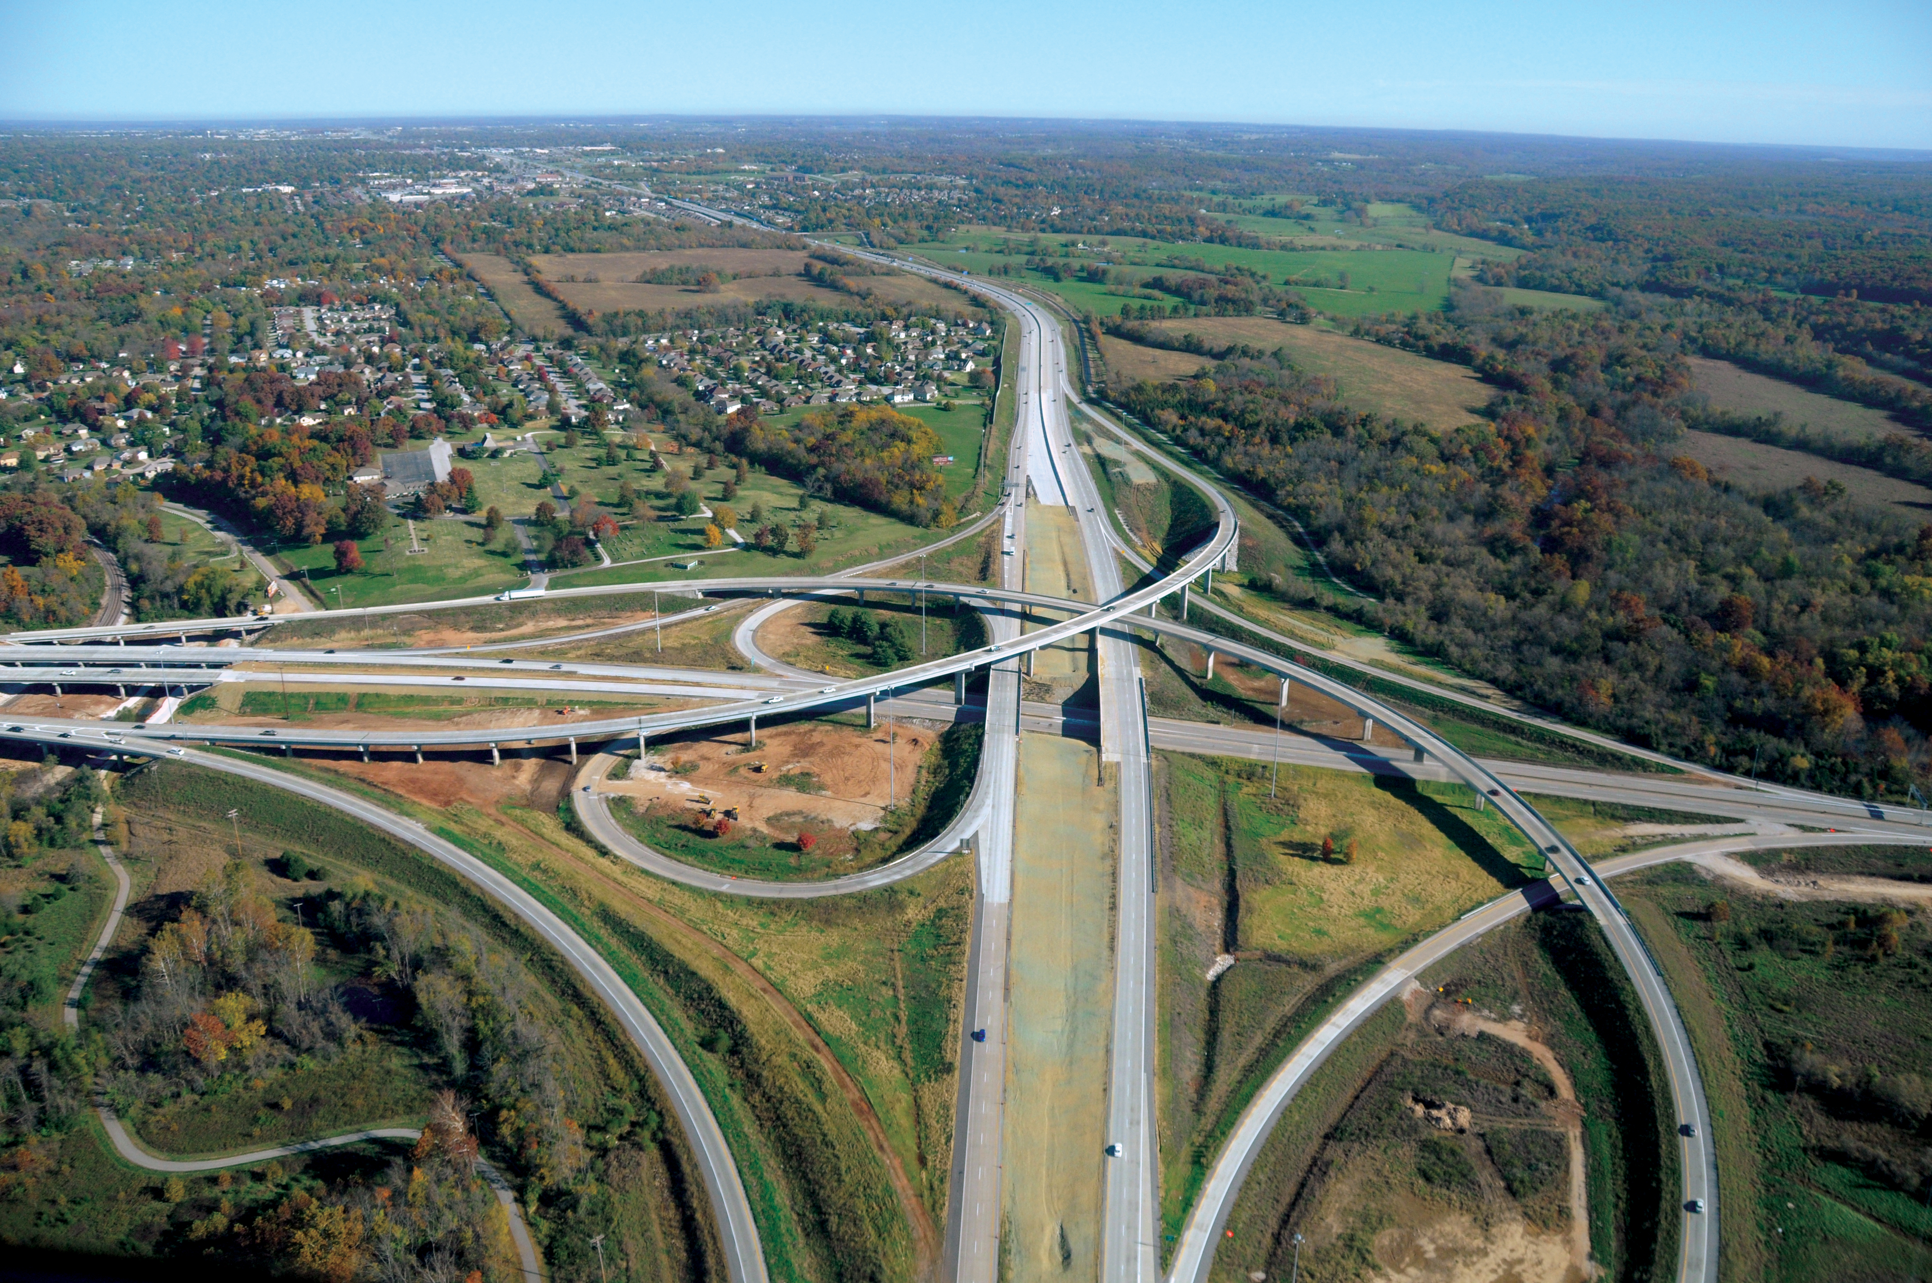
LRTP
TIP
Construction

Slide 3
Transportation Improvement Program
4-year program of capital and non-capital surface transportation projects
Reflect investment priorities established in Destination 2045
Designed to make progress toward achieving performance targets
Include projects that propose to use federal funding
Contain regionally significant projects regardless of funding
Be fiscally constrained

Slide 4
Public Input prior to TIP Development
Draft for Public Comment
TPC Recommendation to BOD
BOD Approval
ONEDOT Approval
Project Solicitation

Slide 5
Public Input/Comment
OTO shares all input with TPC and Board as received
All input received throughout the year is combined and shared with TPC ahead of TIP development
Drafts available for Public
OTO Offices
OTO Website
Library Center
Library Station
Christian County Library - Ozark
CU Transit
MoDOT Southwest District Office
Notice published in News-Leader
Review of Comments and time for public comment at July Board of Directors Meeting

Slide 6
TIP Contents
Introduction
Status of Prior Projects
Financial Capacity
Federal Aviation Eligible Projects
Federal Highway and MoDOT Eligible Projects
Federal Transit Eligible Projects
Regulations and Certifications
Public Input
Performance Based Planning

Slide 7
State and Federal Revenue 2025-2028

Slide 8
Programmed Projects by Year

Slide 9
Programmed Funding FY 2025 through FY 2028

Slide 10
Cost Shares
ITS Operations and Management
Route MM from I-44 to Route 360
Route CC from Fremont to 22nd in Ozark

Slide 11
Prioritized Projects
Projects advanced a fiscal year between the FY 2024-2028 STIP and the Draft FY 2025-2029 STIP
SP2310 - (2025, moved from 2026) I-44- Six lanes and pavement rebuild from Route 13 to Glenstone

Slide 12
Prioritized Projects
Projects that stayed in the same fiscal year between the FY 2024-2028 STIP and the Draft FY 2025-2029 STIP:
OK2102 - (2025) CC Widening from US65 to Fremont in Ozark
OK2202 - (2025) CC/22nd Intersection Improvements in Ozark
OK2203 - (2025) 65/CC/J Ramp/Bridge Improvements
ST2201 - (2025) 125 Roundabout/Intersection Improvements in Strafford
SP2203 - (2025) I-44- Six lanes and pavement rebuild from Glenstone to US 65
RP1704 - (2025) MM - Relocation and RR Bridge
RP1703 - (2025) MM - Add lanes from I-44 to James River Freeway
SP1413/SP1802 - (2025) ADA/Safety Improvements on Sunshine
OK2201 - (2027) MO14 widening from 6th to 14th
SP2301 - (2027) 13/44 interchange Improvements- Phase I
SP2302 - (2028) 13 (Kansas) widening from Grand to Sunshine

Slide 13
Prioritized Projects
Projects delayed a fiscal year between the FY 2024-2028 STIP and the Draft FY 2025-2029 STIP:
NX2202 - (2025, moved from 2024) Roundabout at Main and CC in Nixa
SP2306 - (2026, moved from 2025) Roundabouts at 266/AB and 266/B
RP2303 - (2028, moved from 2027) US 60 Improvements from James River Freeway to FR 103
GR1403 - (2029, moved from 2028) US60 Improvements from 65 to NN/J
(2029, moved from 2028) Glenstone Operational and Pedestrian Improvements – Phase II

Slide 14
Scoping - Prior Prioritization Programmed Projects
EN1901 – Route 744 ADA Improvements
EN2002 – ADA Improvements at Various Locations
EN2006 – Kearney ADA Improvements West Bypass to Kansas Expressway
EN2007 – ADA Sidewalk Upgrade on Chestnut and Glenstone
GR1403 – Capital Improvements on Route 60 East
GR2302 – I-44 Pavement Improvements
MO2215 – ITS on Chestnut Expressway from West Bypass to Kansas Expressway
NX2202 – Route CC Roundabout at Main Street in Nixa
OK2201 – MO 14 Roadway Improvements 6th Avenue to 14th Avenue
OK2202 – RT CC Intersection Improvements in Ozark
RP1703 –Route MM Improvements – I-44 to Route 360
RP1704 – Route MM Railroad Crossing Improvements
RP2201 – RT MM Ramp Intersection Improvements at I-44
SP1413 – Sunshine Street ADA Improvements
SP1802 –Safety and Operational Improvements on Sunshine Street
SP1812 – Chestnut Expressway Safety Improvements
SP2203 – I-44 Roadway Improvements Glenstone to US 65 in Springfield
SP2218 – Glenstone Operational and Pedestrian Improvements
SP2301 – I-44 and Kansas Interchange Improvements
SP2302 – Kansas Expressway Capital Improvements

Slide 15
Transit
Operating Assistance and Paratransit Operations
Preventative Maintenance
Transit Planning
Transit Security/Safety
Beyond ADA
Human Service Vehicles
Bus Replacement

Slide 16

Progress toward Performance Targets
Performance Target Setting
Performance Plans
Projects that Support Targets
MoDOT Targets
OTO Targets
Long Range Plan
Congestion Management
OTO reports to MoDOT
MoDOT Reports to U.S. DOT
TIP
Construction and Capital
Maintenance
Operations and Incident Mangement
Travel Demand Management
Performance Reporting

Slide 17
Progress toward Performance Targets
Supporting State Targets
Bike/Ped or Projects including Bike/Ped
Safety
Asset Management
Transit Preventative Maintenance and Bus Replacement
Nearly $225 million
44%
$15 million
Nearly $107 million
Transit Safety
$1.2 million

