Slide 1

Transit Coordination Plan 2022

Slide 2

Transit Coordination Plan
Outline
Why do we have/update the TCP?
Who updates the TCP?
What does the updated TCP propose?
2

Slide 3

Federal Requirements
Coordinated Public Transit-Human Services Transportation Plan (CPT-HSTP)
Section 5310: Elderly Individuals and Individuals with Disabilities
Section 5316: Job Access and Reverse Commute Program
Section 5317: New Freedom
12

Slide 4
Federal Requirements
Coordinated Public Transit-Human Services Transportation Plan (CPT-HSTP)
Section 5310: Enhancing Mobility for Elderly Individuals and Individuals with Disabilities
Section 5316: Job Access and Reverse Commute Program Formula Funds
Section 5317: New Freedom Section 5310
12

Slide 5
Federal Requirements
Coordinated Public Transit-Human Services Transportation Plan (CPT-HSTP)
Section 5310: Enhancing Mobility for Elderly Individuals and Individuals with Disabilities
12

Slide 6
Local Coordinating Board for Transit
Brandie Fisher, City Utilities Transit, Co-Chair
Jeff Robinson, OATS, Inc, Co-Chair
Bill Achor, Ozark Senior Center/Christian County Senior Tax Board
Shelby Butler, Empower:Abilities
Haley Powell, SeniorAge
Linda Starr, SWI Industrial Solutions
Leslie McCafferty, Burrell Behavioral Health
Ex Officio Members
Eva Steinman, FTA Region 7
Christy Evers, MoDOT Transit
Janette Vomund, MoDOT Transit
Kimberly Ader, MoDOT SW District
6

Slide 7
Transit Coordination Plan
Contents
Background
Regional Profile
Needs Assessment
Strategic Framework
Actions and Implementation
7

Slide 8
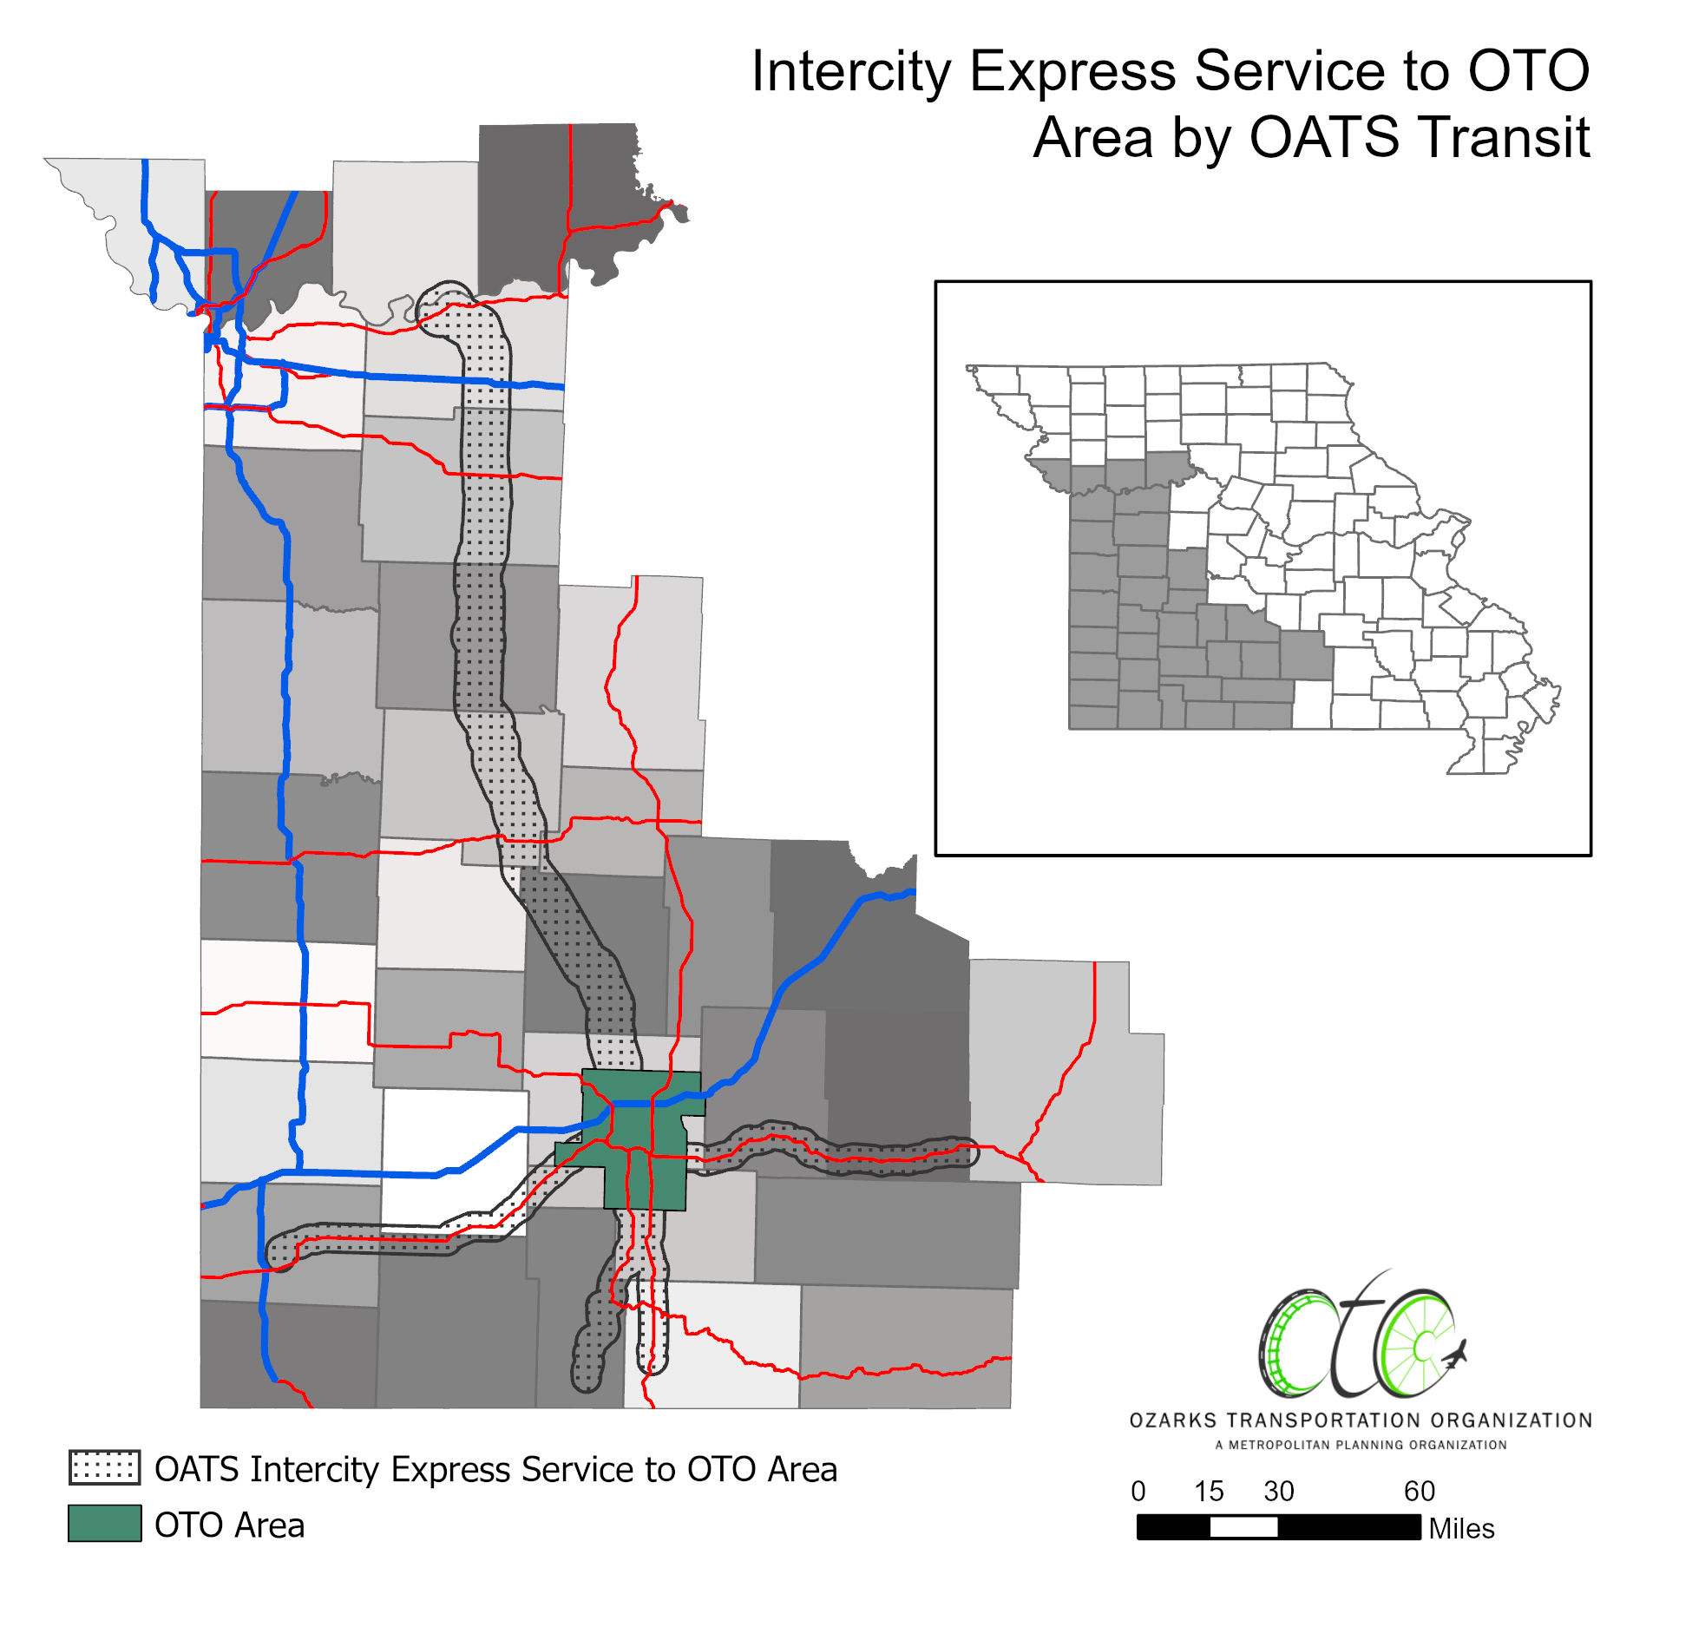
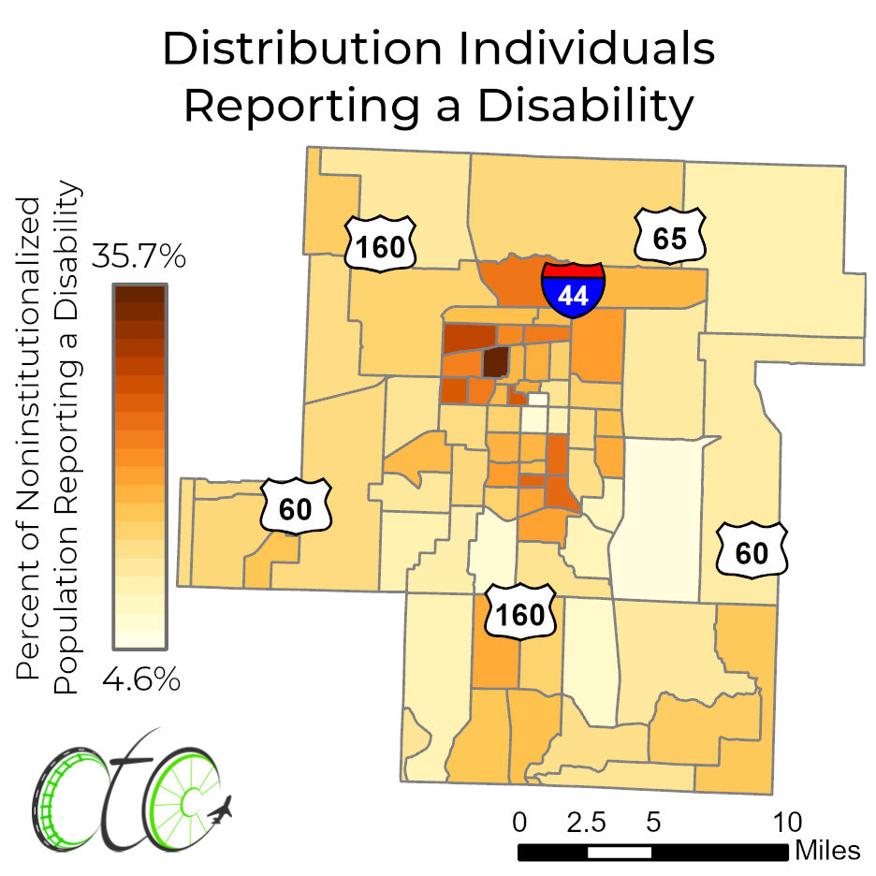
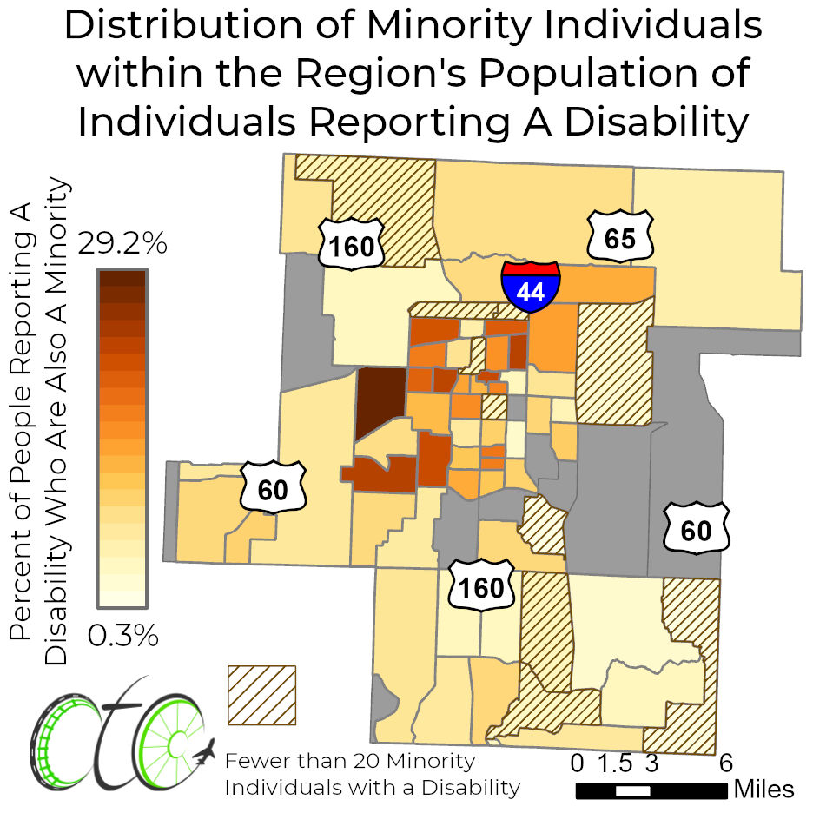
Regional Profile
Key Populations
Seniors
Individuals with Disabilities
Individuals with Limited Incomes
Existing Transit Services
8

Slide 9
Needs Assessment
User Identified Service Gaps
2017 |  | 2022
Inter-city Connections |  | Inter-city Connections
Trip Scheduling |  | Trip Scheduling
Hours of Service |  | Hours of Service
Access to Special Events/Destinations |  | First- and Last-Mile Connections
Veterinarian Trips |  | Service Frequency
9

Slide 10
Needs Assessment
Human Service/Transportation Provider Needs
Human Service Agencies
Regional Service
Partnerships to Control Costs
Transportation Providers
Timely Vehicle Acquisition
Rising Costs
Staffing
Resources to Support Growing Service Opportunities
Senior Population Growth
Service Coordination
10

Slide 11
Strategic Framework
Plan Strategies
1. Education and Advocacy
2. Improve Mobility Services and Infrastructure
3. Expand Mobility Services and Infrastructure
4. Regionalize Service
11

Slide 12
Actions and Implementation
Plan Strategies
Education and Advocacy
Transit Provider Brochure
Support Local Initiatives
Improve Mobility Services and Infrastructure
Expand Mobility Services and Infrastructure
Regionalize Service
2017 User Identified Service Gaps
Inter-city Connections
Trip Scheduling
Hours of Service
Access to special events/destinations
Veterinarian Trips
12

Slide 13
Actions and Implementation
Plan Strategies
Education and Advocacy
Transit Provider Brochure
Support Local Initiatives
Improve Mobility Services and Infrastructure
Replacement Vehicles
Improve Existing Pedestrian/Bicycle Infrastructure
Support Flexible Scheduling Policies
Identify Operational Funding
Expand Mobility Services and Infrastructure
Regionalize Service
2017 User Identified Service Gaps
Inter-city Connections
Trip Scheduling
Hours of Service
Access to special events/destinations
Veterinarian Trips
13

Slide 14
Actions and Implementation
Plan Strategies
Education and Advocacy
Transit Provider Brochure
Support Local Initiatives
Improve Mobility Services and Infrastructure
Replacement Vehicles
Improve Existing Pedestrian/Bicycle Infrastructure
Support Flexible Scheduling Policies
Identify Operational Funding
Expand Mobility Services and Infrastructure
Purchase New Vehicles
Expand Pedestrian/Bicycle Infrastructure
Timely Vehicle Acquisition
Employment Access
High Frequency Corridors
Mobility Management
Regionalize Service
2017 User Identified Service Gaps
Inter-city Connections
Trip Scheduling
Hours of Service
Access to special events/destinations
Veterinarian Trips
14

Slide 15
Actions and Implementation
Plan Strategies
Education and Advocacy
Transit Provider Brochure
Support Local Initiatives
Improve Mobility Services and Infrastructure
Replacement Vehicles
Improve Existing Pedestrian/Bicycle Infrastructure
Support Flexible Scheduling Policies
Identify Operational Funding
Expand Mobility Services and Infrastructure
Purchase New Vehicles
Expand Pedestrian/Bicycle Infrastructure
Timely Vehicle Acquisition
Employment Access
High Frequency Corridors
Mobility Management
Regionalize Service
Expanded Intercity Service
Intracity Service In More Communities
2017 User Identified Service Gaps
Inter-city Connections
Trip Scheduling
Hours of Service
Access to special events/destinations
Veterinarian Trips
15

Slide 16
Actions and Implementation
Plan Strategies
Education and Advocacy
Transit Provider Brochure
Support Local Initiatives
Improve Mobility Services and Infrastructure
Replacement Vehicles
Improve Existing Pedestrian/Bicycle Infrastructure
Support Flexible Scheduling Policies
Identify Operational Funding
Expand Mobility Services and Infrastructure
Purchase New Vehicles
Expand Pedestrian/Bicycle Infrastructure
Timely Vehicle Acquisition
Employment Access
High Frequency Corridors
Mobility Management
Regionalize Service
Expanded Intercity Service
Intracity Service In More Communities
2017 User Identified Service Gaps
Inter-city Connections
Trip Scheduling
Hours of Service
Access to special events/destinations
Veterinarian Trips
16

